Slide 1




FeFET
in 22nm FDSOI
for fast, low-power, non-volatile memory
Presentation by:
Khalil Ouali
Khumar Huseynzade
Olya Tsormutyan
Nanotechnology course — Dr. Andreas Bablich
Winter Semester 2025-2026

Slide 2
High-Capacity Non-Volatile Memory [5][3]
Limitations:
⚡ High Power Consumption
🕝 Slow Speed
📉 Quick Degradation
💰 High Cost
☢️ Radiation Susceptibility
Limited Applications:
📱 Embedded and IOT 🌐
🛰️ Space and Nuclear ⚛️
⇒ Alternative: FeFET
Simplified Floating-Gate FET operation in traditional flash memory
Program / Erase
Read
Control Gate
(Poly)
Low Voltage
± Large Voltage
Inter-Poly Dielectric
Floating Gate (Poly) or Charge Trap Layer (SiNₓ)
± Charge Storage
High/Low Drain Current
Tunnel Oxide
Drain (n⁺)
Source (n⁺)
p-substrate
Notes:
Program/erase: ±8-12V
Power consumption: high voltage and some current for charge/discharge
Tradeoff between power and speed, and between speed and endurance, depending on voltage
High cost due to complex process integration
Cosmic ionizing radiation can charge/discharge a cell spontaneously, corrupting data

Slide 3
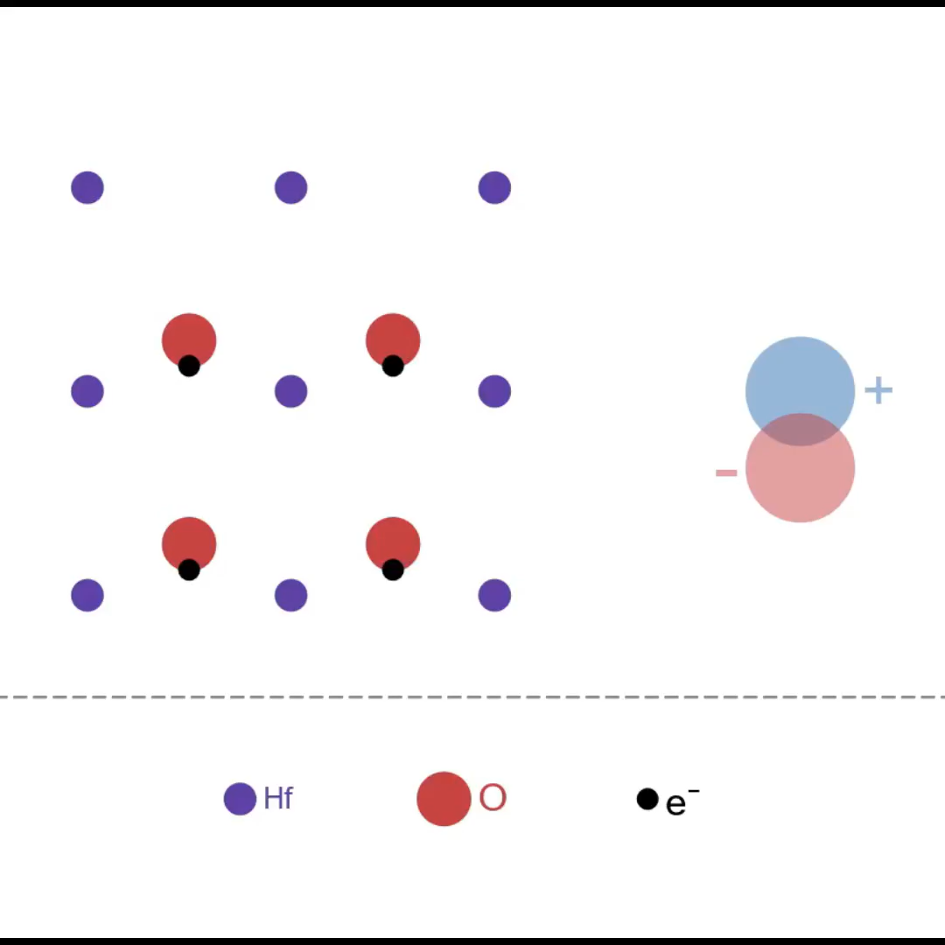
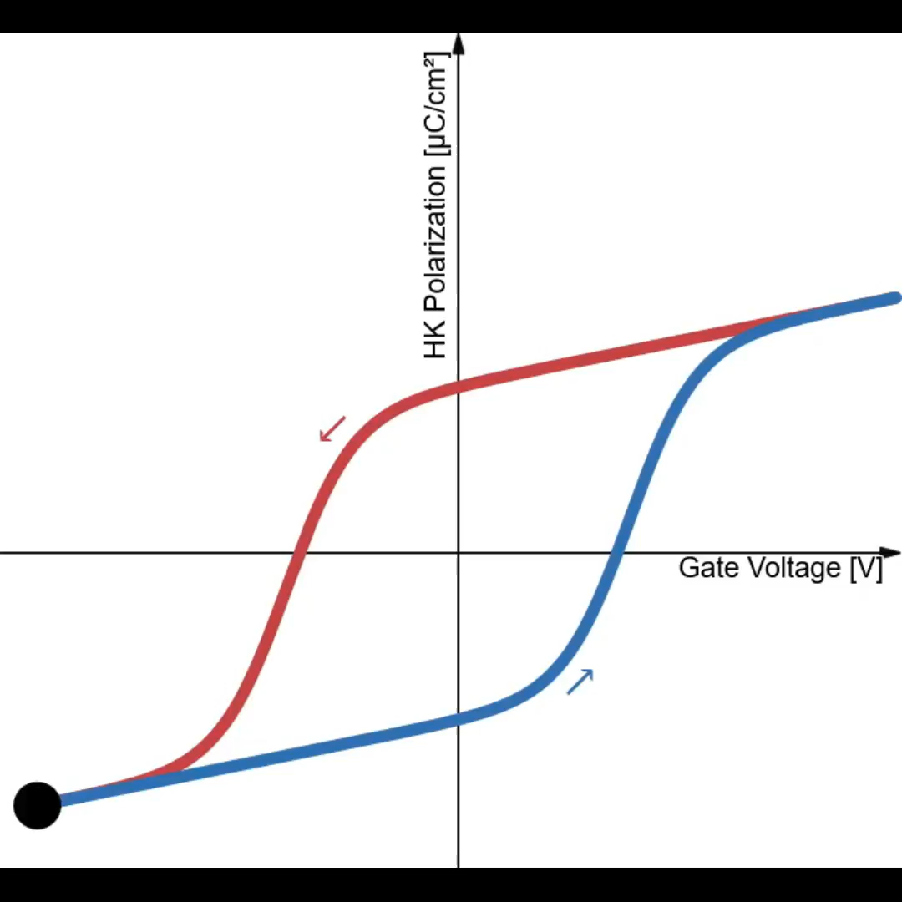
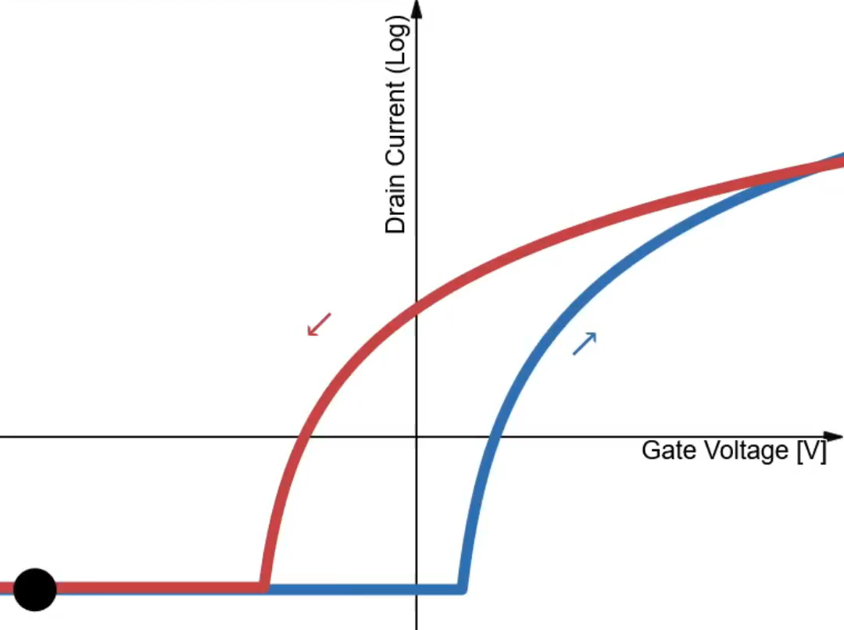
Operation Principle
Simplified visualization of ferroelectric crystal polarization
👆 Click here to visit Desmos link (online animation)
G
Ferro
HK
S
Channel
D
Hysteresis curve of ferroelectric polarization as a function of voltage
FeFET drain current as a function of gate voltage
Simplified FeFET structure
Notes:
Oxygen is highly electronegative; electrons stick to it.
It has 2 stable positions. Enough force (electric field) can snap it to another position.

Slide 4
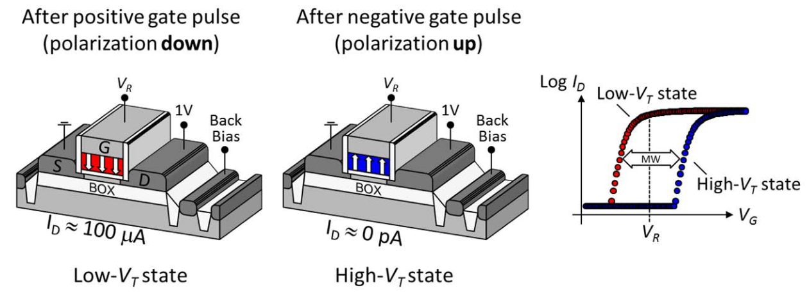
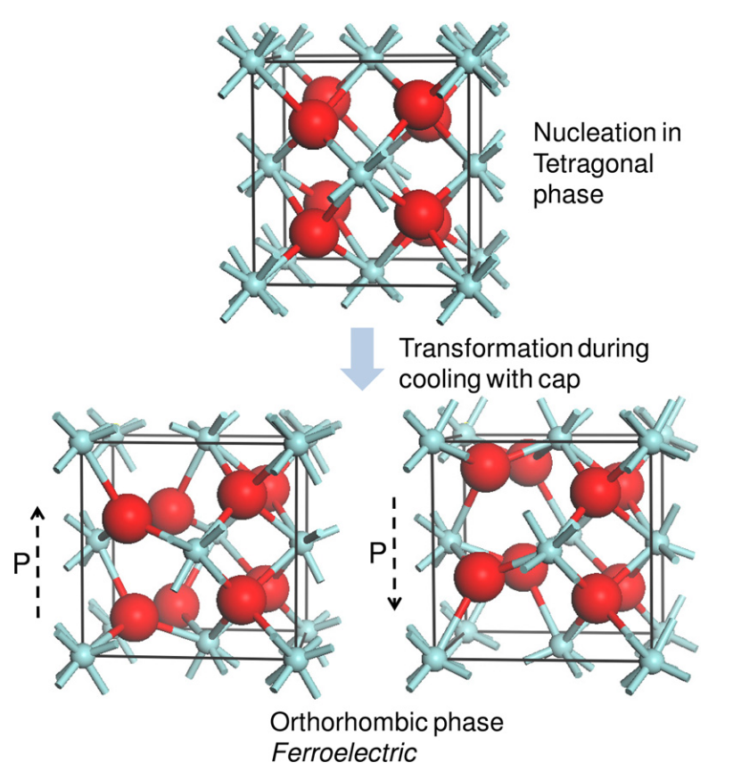
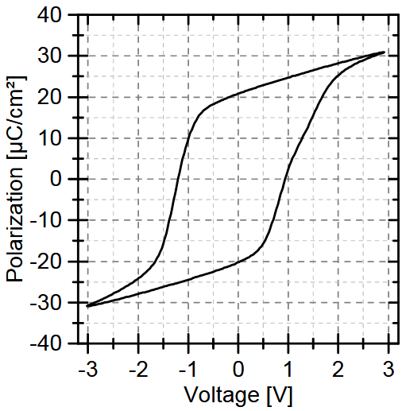
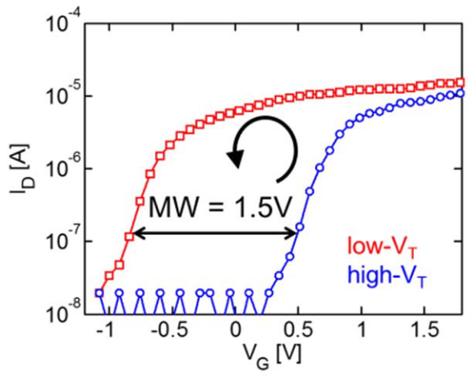
Operation Principle
FeFET states [1]
Ferroelectric Si:HfO₂ : Fabrication and Polarizations [2]
Hysteresis in FeFET transfer curve [1]
Polarization hysteresis in ferroelectric Si:HfO₂[3]
Notes:
Voltage: High + → program, High - → erase, Low → read

Slide 5
Fabrication [1][2][3][4][Course][+]
Si wafer with ultra thin body and buried oxide (UTBB)
After cleaning, padding, Shallow Trench Isolation (STI)
BOX
Si
SiO₂
Notes:
Moving onto the fabrication of the device, we don't have exact details about the process since it's proprietary, but this is our best inference based on various sources including our course.
This device is fabricated in a Fully-Depleted Silicon-on-Insulator process, so we will need a buried oxide, and unlike regular SOI, we will keep the body silicon layer very thin and without channel doping, such that the depletion regions from the drain and source cover the entire channel length.
We will skip a few steps that aren't very relevant to our device like the wafer preparation, box implantation, and shallow trench isolation.
--
Buried oxide ← ion implantation followed by anneal
Silicon thickness = 5-10nm

Slide 6
Rapid Thermal Oxidation (RTO) + Nitridation (RTN)
⇒ Interfacial layer (IL)
! Fully-Depleted SOI doesn't require channel doping
! Gate First process
BOX
Si
SiO₂
SiON
Notes:
This is a gate-first process, so we will deposit the full gate stack and pattern it later, starting with a thin interfacial layer done by rapid thermal oxidation and nitridation.
---
Advantage of gate-first: thermal budget as doping happens later so diffusion isn't as harmful

Slide 7
Atomic Layer Deposition (ALD) of Si:HfO₂
→ Amorphous, lightly-doped, High-K dielectric (HK)
! Additional masks to select FeFETs vs logic FETs
HK
BOX
Si
SiO₂
SiON
Si:HfO₂
Notes:
Next, we use atomic layer deposition to grow an amorphous layer of high-k dielectric hafnium dioxide with light silicon doping.
During this step, we require additional masks to select different FETs, logic or ferroelectric, and deposit accordingly.

Slide 8
ALD / Physical Vapor Deposition (PVD) of TiN
⇒ Metal gate
MG
HK
BOX
Si
SiO₂
SiON
Si:HfO₂
TiN
Notes:
Over the HK layer we deposit the gate metal, Titanium Nitride, using PVD (or ALD again).

Slide 9
Rapid Thermal Annealing (RTA) → Encapsulated Si:HfO₂ Crystallization
⇒ Ferroelectric HK
MG
Ferro-HK
BOX
Si
SiO₂
SiON
Si:HfO₂
TiN
Notes:
One critical detail is that we need to crystallize the HK using rapid thermal annealing after the metal deposition, and not before.
The light silicon doping, combined with the encapsulation, is what crystallizes the material into a ferroelectric phase.

Slide 10
Low Pressure (LP) Chemical Vapor Deposition (CVD) of Poly-Si
Poly-Si
MG
Ferro-HK
BOX
Si
SiO₂
SiON
Si:HfO₂
TiN
Notes:
Next, we finish the gate stack with the low-pressure chemical vapor deposition of a poly-crystalline silicon layer.

Slide 11
Photolithography + Multi-Step Reactive Ion Etching (RIE)
⇒ Gate Patterning
Poly-Si
MG
Ferro-HK
BOX
Si
SiO₂
SiON
Si:HfO₂
TiN
Notes:
We pattern the gates using photolithography and multi-step reactive ion etching.

Slide 12
Ion Implantation of P / As / Sb → Low N-type doping
⇒ Lightly-Doped Drain (LDD) and Source
Poly-Si
MG
Ferro-HK
n⁻
Channel
n⁻
BOX
Si
SiO₂
SiON
Si:HfO₂
TiN
Notes:
After which we do light N-doping for the lightly doped drain and source
--
Phosphor / Arsenic / Antimony

Slide 13
LPCVD of Undoped Silicate Glass (USG) and/or Nitride
+ RIE ⇒ Sidewall Spacers
Poly-Si
MG
Ferro-HK
n⁻
Channel
n⁻
BOX
Si
SiO₂
SiON
Si:HfO₂
TiN
Notes:
We add the sidewall spacers using LPCVD and anisotropic reactive ion etching.

Slide 14
Selective Epitaxy with In-Situ N-Type Doping of P + RTA
⇒ Raised Source & Drain
Poly-Si
MG
n⁺
Ferro-HK
n⁺
n⁻
Channel
n⁻
BOX
Si
SiO₂
SiON
Si:HfO₂
TiN
Notes:
Then we do selective epitaxy with in-situ N-type doping in order to create raised source and drain
--
Raised source and drain advantage: Reduced series resistance and additional volume for silicidation
P: Phosphorus
Selective epitaxy with in-situ doping is essentially CVD.

Slide 15
PVD of Ni + Annealing + Unreacted metal strip
⇒ Self-aligned Silicide (Salicide)
Silicide
Poly-Si
Silicide
Silicide
MG
Ferro-HK
n⁺
n⁺
n⁻
Channel
n⁻
BOX
Si
SiO₂
SiON
Si:HfO₂
TiN
NiSi
Notes:
After using PVD for Nickel deposition, annealing, and etching unreacted metal, we get a salicide layer for each contact
--
Low-temp anneal
Strip: wet etch
Silicide advantage: low contact resistivity

Slide 16
CVD of Phospho-Silicate Glass (PSG) + Photolithography + W + CMP
W Plug
PSG
Silicide
PSG
W Plug
Poly-Si
Silicide
Silicide
MG
Ferro-HK
n⁺
n⁺
n⁻
Channel
n⁻
BOX
Si
SiO₂
SiON
Si:HfO₂
TiN
NiSi
P:SiO₂
W
Notes:
Finally, we finish with the PSG deposition, Tungsten plugs, and final cleanup, thus arriving at the final structure.

Slide 17
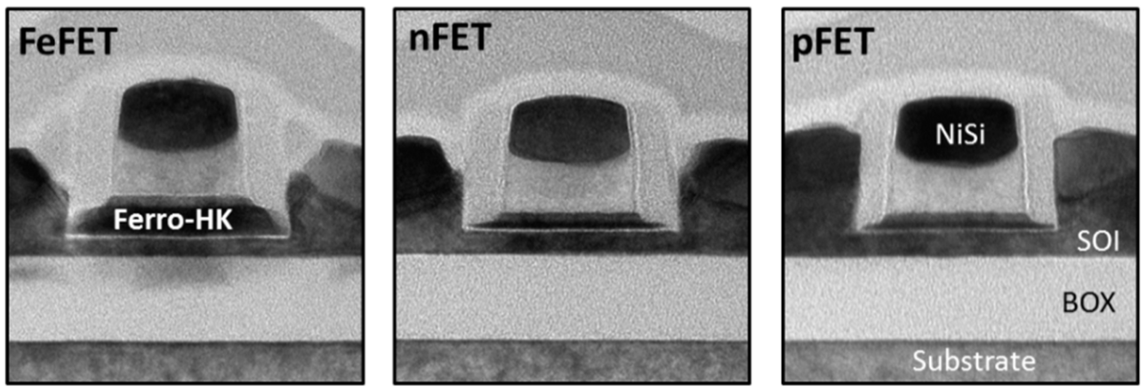
Final Structure
22nm FeFET TEM cross-section [1]
W Plug
PSG
Silicide
PSG
W Plug
Poly-Si
Silicide
Silicide
MG
Ferro-HK
n⁺
n⁺
n⁻
Channel
n⁻
BOX

Slide 18
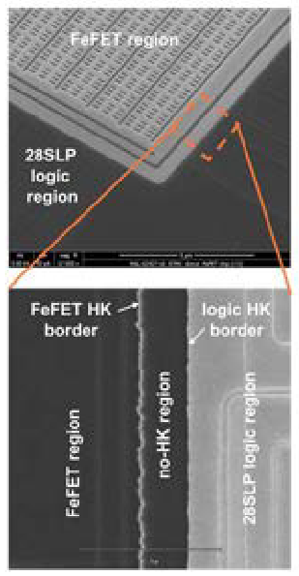
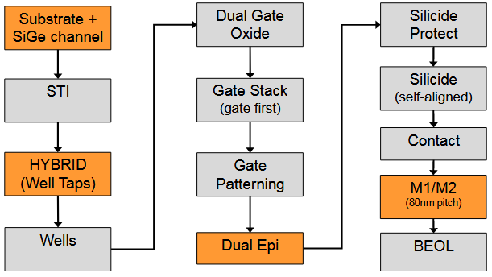
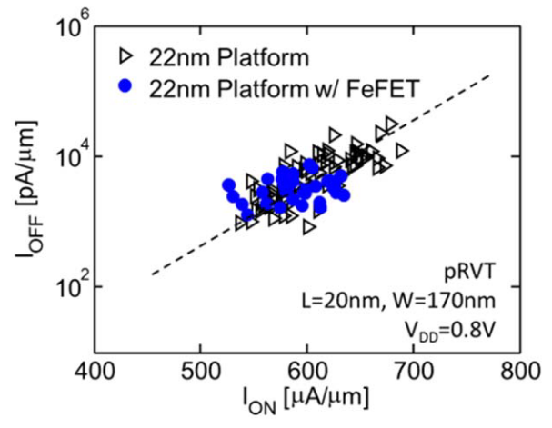
Process Integration
TEM cross-sections of 22nm FDSOI FeFET and logic FETs [1]
Logic FET performance in 22nm FDSOI with and without FeFET integration [1]
22nm FDSOI base process flow [4]
SEM of 28nm embedded FeFET NVM border [3]
Notes:
- The fabrication of these devices was successfully integrated into a commercial FDSOI CMOS process called 22FDX that is offered by global foundries.
- On the top right you can see TEM cross-sections of an nmos and pmos fabricated on the same die.
- On the left we have a scanning electron micrograph of the die, but for 28nm node, highlighting the separation between the FeFET region with Ferro-HK, and standard logic FETs with normal HK.
-The flow diagram in the middle presents the original 22nm process excluding the FeFET specific steps, but the paper mentions that only 2 mask additions are required, presumably for the FET selection.
- And the integration is non-invasive, as shown in this graph on the right, the performance of the logic FETs essentially doesn't change with the addition of the FeFET steps.
---
Orange parts:
- SiGe channel and Dual-epi for improved pMOS performance in FDSOI,
- Hybrid (well taps) because this process actually combines FDSOI and non-SOI (just bulk silicon) for maximum flexibility,
- Metal 1 and 2 patterning offers more control over those two metal layers (not sure what for exactly)

Slide 19
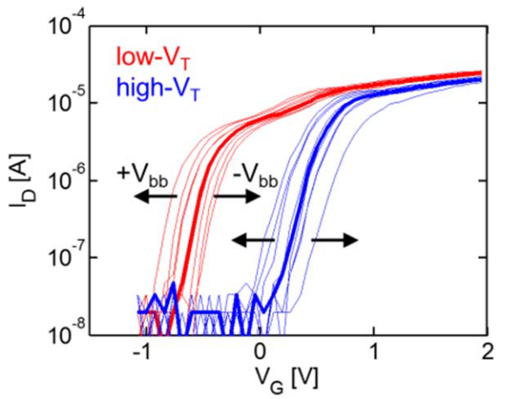
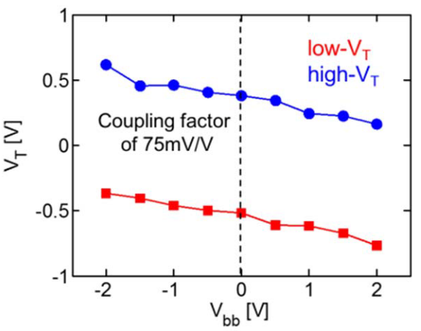
Performance
Low- and high-Vₜ (±3.8V, 10μs) transfer curves of a 80x20nm FDSOI FeFET [1]
Back-Biasing
Effect of back-biasing on threshold voltages [1]
FeFET structure incl. back-biasing [1]
Effect of back-biasing on transfer curve[1]
Notes:
Back-biasing shifts both threshold voltages in the same direction, barely affecting the window size.
Vbb applied to substrate (bulk), and produces a field effect like the gate.
It has the same effect as the gate voltage (not unlike gate-all-around) but much weaker. +Vbb attracts electrons, helps form channel, lowering Vth, and vice-versa.

Slide 20
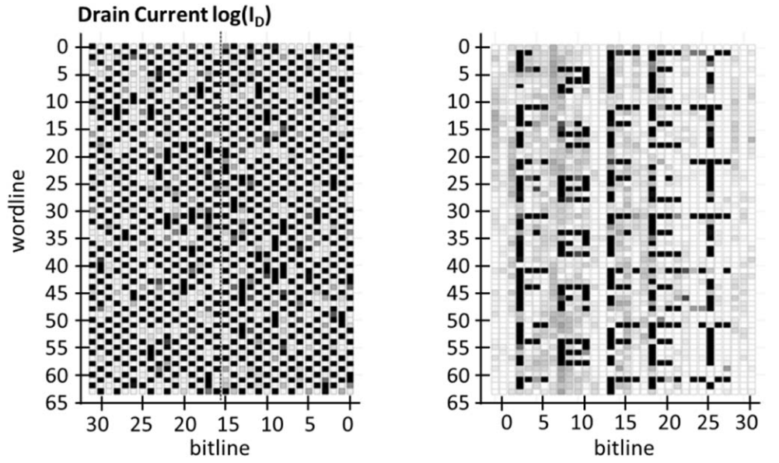
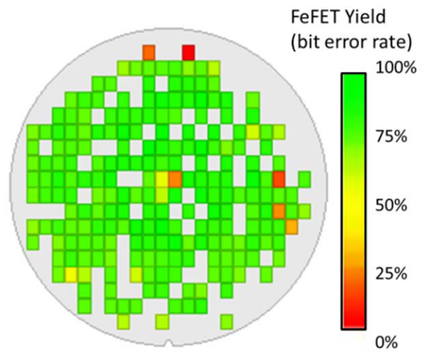
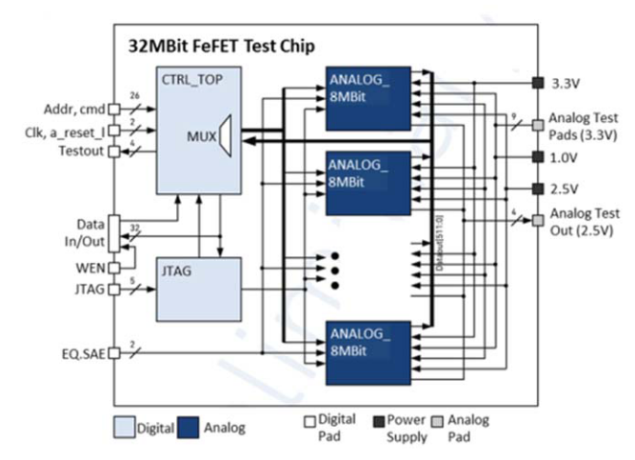
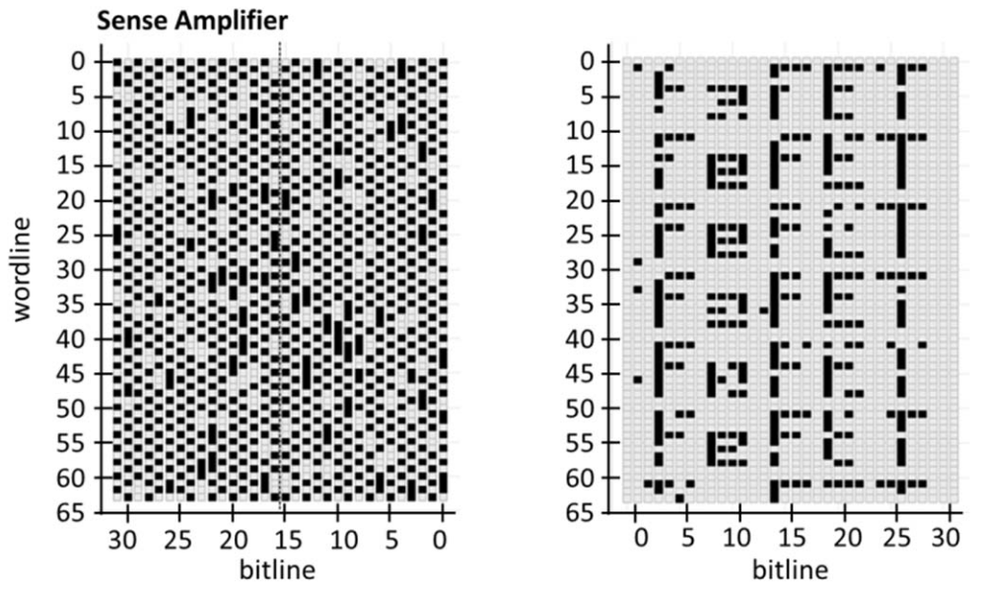
Memory Array Testing
Memory array test circuit [1]
Drain current (↑) and bit (↓) readouts after
writing checkerboard and complex patterns
in a 0.036μm² cell 32MBit array [1]
FeFET logic yield, limited mainly due to defects [1]
Notes:
Bit error rate is how many bits of the programmed pattern were wrong when read back

Slide 21
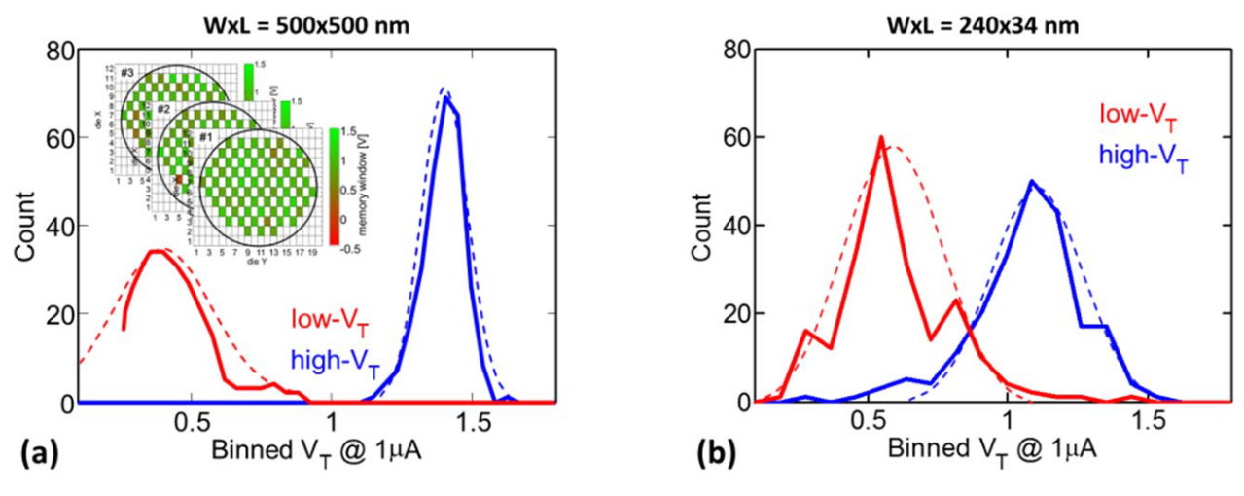
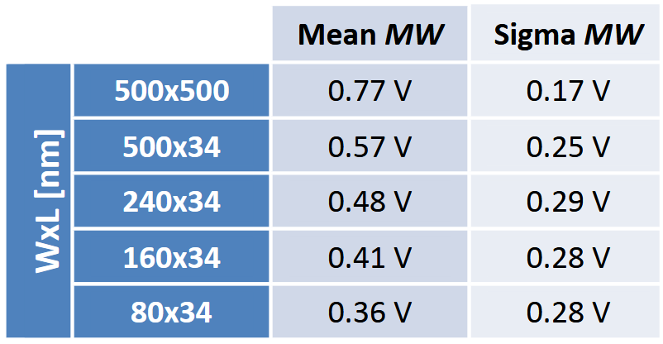
Size vs Performance
Threshold voltage distribution for different sizes [1]
Memory window and variation for FeFETs with different device dimensions [1]
Notes:
At smaller sizes, memory window shrinks and variation increases, which is bad

Slide 22
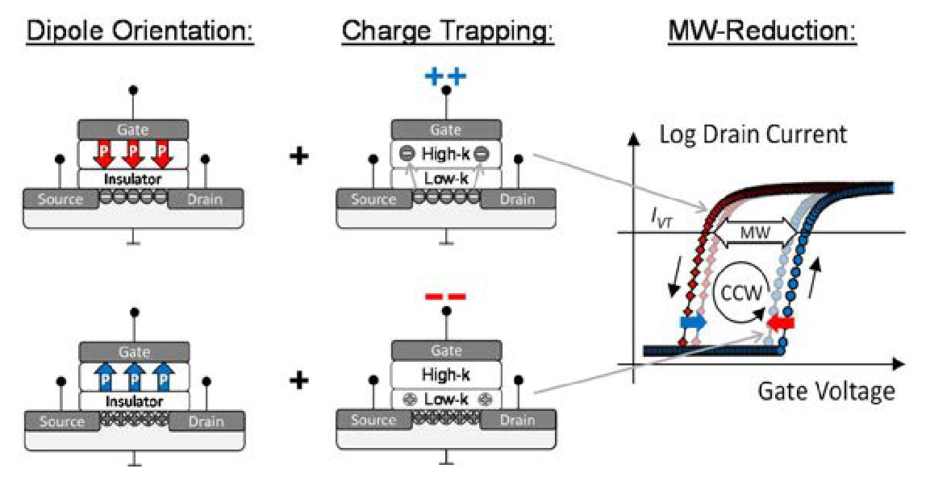
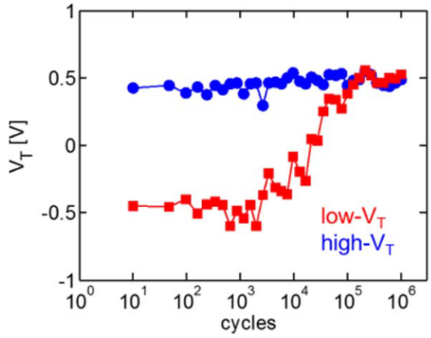
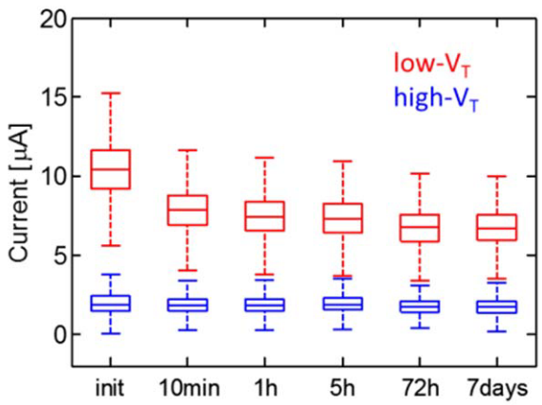
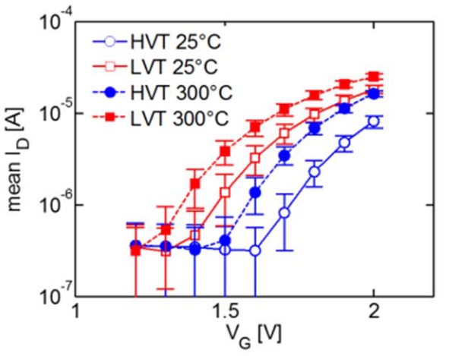
Endurance
Charge trapping, counteracting the ferroelectric polarization [3]
Bipolar endurance cycling (±3.5V, 10μs) of a 170x24nm FeFET [1]
Retention measurement of 0.28μm² cell 64 kBit array @ 250 °C [1]
Retention measurement of 0.28μm² cell 64 kBit array @ 300 °C after 1 h [1]
Notes:
Issues at the interface cause ion migration and charge trapping in the high-K, narrowing the memory window
250°C: most degradation happens in the first few minutes, then stabilizes somewhat
300°C: the heat had similar effects on both threshold voltages, so memory window doesn't shrink too much

Slide 23
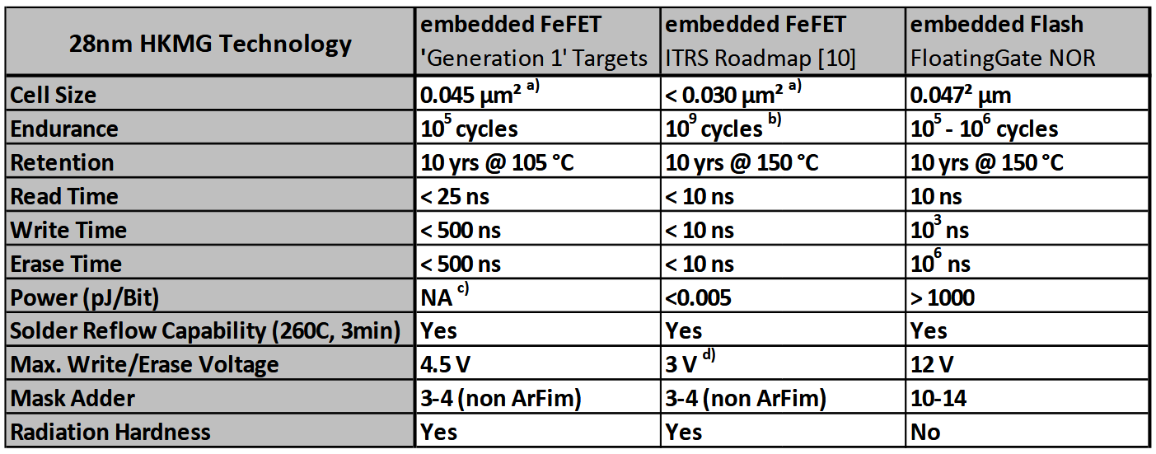
Comparison with Flash (28nm)
📉 Durability
🕝 Speed
⚡ Power
💰 Cost
☢️ Radiation
Prospects of hafnium-based FeFET eNVM for the ‘Generation 1’ flow vs. best projected values taken from the ITRS and embedded Flash. [3]
Notes:
Power consumption not exactly quantified, but confirmed to be lower than flash

Slide 24
References
[1]
S. Dünkel et al., “A FeFET based super-low-power ultra-fast embedded NVM technology for 22nm FDSOI and beyond,” in 2017 IEEE International Electron Devices Meeting (IEDM), Dec. 2017, p. 19.7.1-19.7.4. doi: 10.1109/IEDM.2017.8268425.
[2]
T. S. Böscke, J. Müller, D. Bräuhaus, U. Schröder, and U. Böttger, “Ferroelectricity in hafnium oxide thin films,” Appl. Phys. Lett., vol. 99, no. 10, p. 102903, Sept. 2011, doi: 10.1063/1.3634052.
[3]
M. Trentzsch et al., “A 28nm HKMG super low power embedded NVM technology based on ferroelectric FETs,” in 2016 IEEE International Electron Devices Meeting (IEDM), Dec. 2016, p. 11.5.1-11.5.4. doi: 10.1109/IEDM.2016.7838397.
[4]
R. Carter et al., “22nm FDSOI technology for emerging mobile, Internet-of-Things, and RF applications,” in 2016 IEEE International Electron Devices Meeting (IEDM), Dec. 2016, p. 2.2.1-2.2.4. doi: 10.1109/IEDM.2016.7838029.
[5]
R. Bez, E. Camerlenghi, A. Modelli, and A. Visconti, “Introduction to flash memory,” Proceedings of the IEEE, vol. 91, no. 4, pp. 489–502, Apr. 2003, doi: 10.1109/JPROC.2003.811702.

Slide 25
Thank you
for your attention

