Slide 1






Republic of Tunisia
Ministry of Higher Education and Scientific Research
University of Tunis El Manar
Faculty of Sciences of Tunis
Department of Information Technology
End-of-Studies Project
Design and Implementation of an RTOS-Powered Codebase for a GPS-Box Embedded Device,
with DevOps Integration and Dashboard Monitoring
Conducted by Khalil Ouali
for the degree of Bachelor in Computer Engineering
Presented before members of the jury:
Dr. Ramzi Zouaoui - President
Dr. Sinda Boussen - Reviewer
Dr. Mohamed Aymen Zermani - Academic Advisor
Mr. Zied Ben Yahya - Professional Advisor

Slide 2
Plan
I
Context
II
Embedded Software
III
Monitoring System
IV
DevOps
V
Conclusion & Prospects
Notes:
for my presentation i have opted for a slightly unconventional plan
where
after exposing the context of the project
i will be addressing each subtopic starting with
and then
followed by
and finally conclude with a review and some prospects

Slide 3
I
Context
1
Project Background

Slide 4








Host Company
· 2016 - Foundation
· 2017 - IoT License
· 2019 - Startup Status
|
· 2023 - $1.6M Raised
|
Notable clients and partners:
Notes:
embedded systems and iot solutions
branches in Mauritania and Bahrain
and expanding (Europe)
Well known partners in Tunisia and abroad

Slide 5


Product
GPS-Box
🗼 GSM Internet Connectivity
🗺️ GPS, Accelerometer
↔ Digital and Analog I/O
↔ USART, USB, CAN, etc.
⌚ Low-Power, Wide Temp-Range
Applications:
✅ Vehicle Tracking and Monitoring
✅ Fleet Management
Notes:
Note Complexity

Slide 6
Problem
Current Software
✅ Fully functional
⛓️ Bare-metal
⏲️ Rudimentary Scheduling
⚒️ Crude Resource Sharing
🪢 Tight Coupling
Shortcomings:
❌ Maintainability
❌ Updatability
❌ Scalability

Slide 7



Solution
RTOS
🔀 Multi-Threading
⌚ Preemptive, Priority-Based Scheduling
🗝️ Controlled Resource Access
Advantages:
✅ Reliability
✅ Modularity
✅ Separation of Concerns

Slide 8


Solution
Testing and DevOps
➕
➕

Slide 9

Addition
Remote Monitoring
➕
➕
➕

Slide 10
I
Context
2
Understanding the Hardware

Slide 11
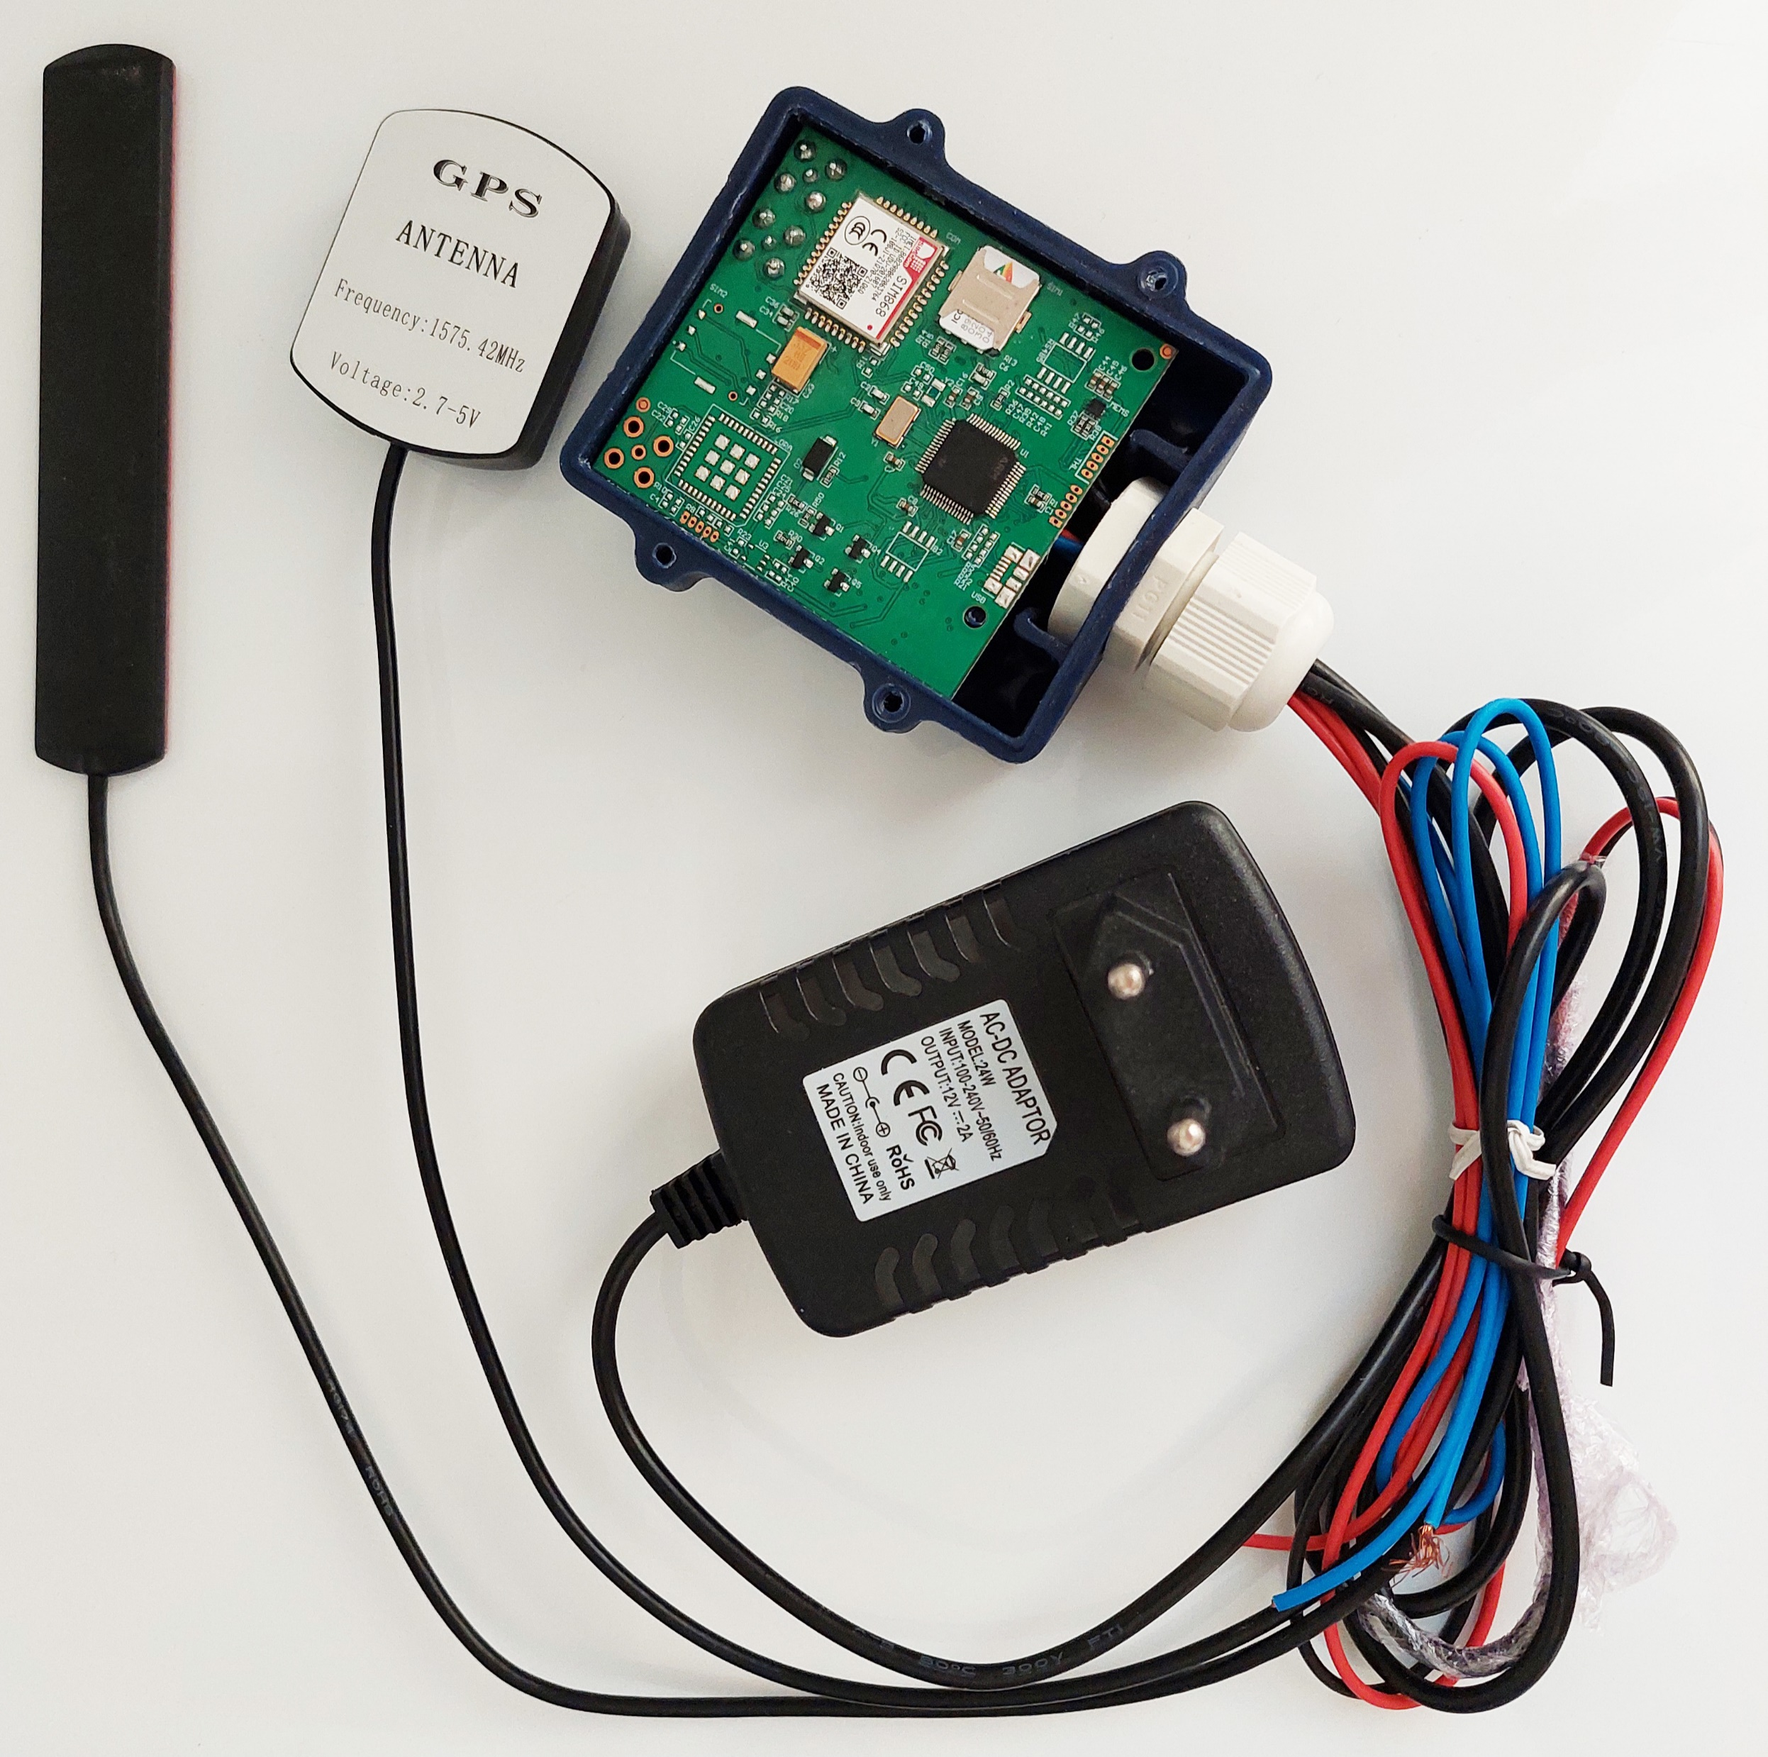
Notes:
Photo of the provided hardware
enclosed PCB with wires for antennae, power, and other things

Slide 12
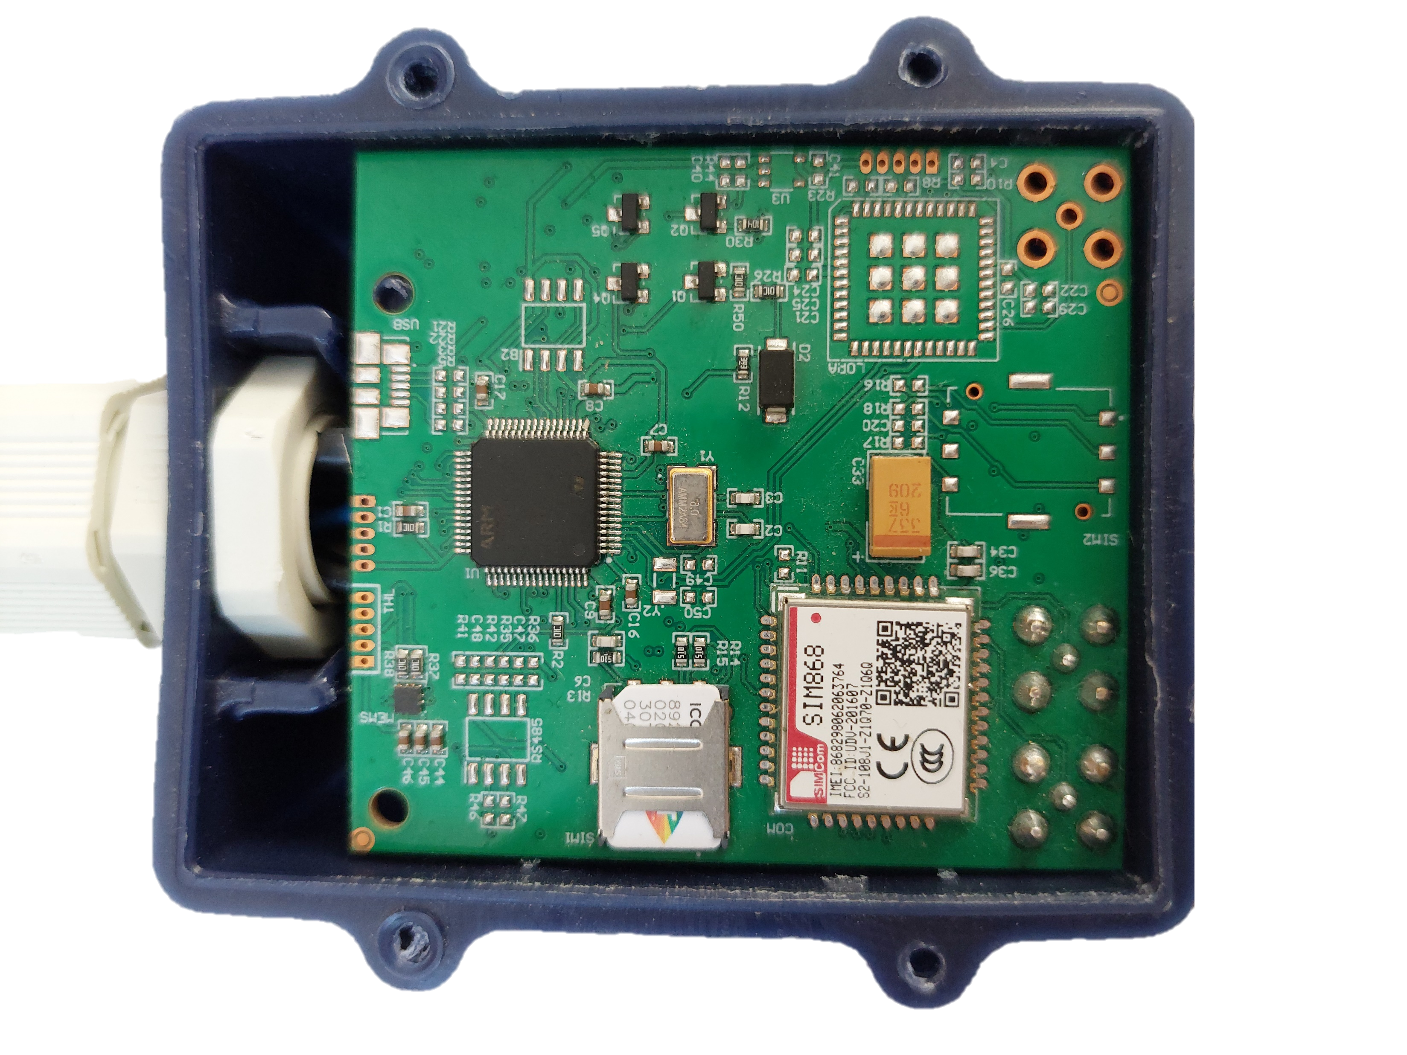
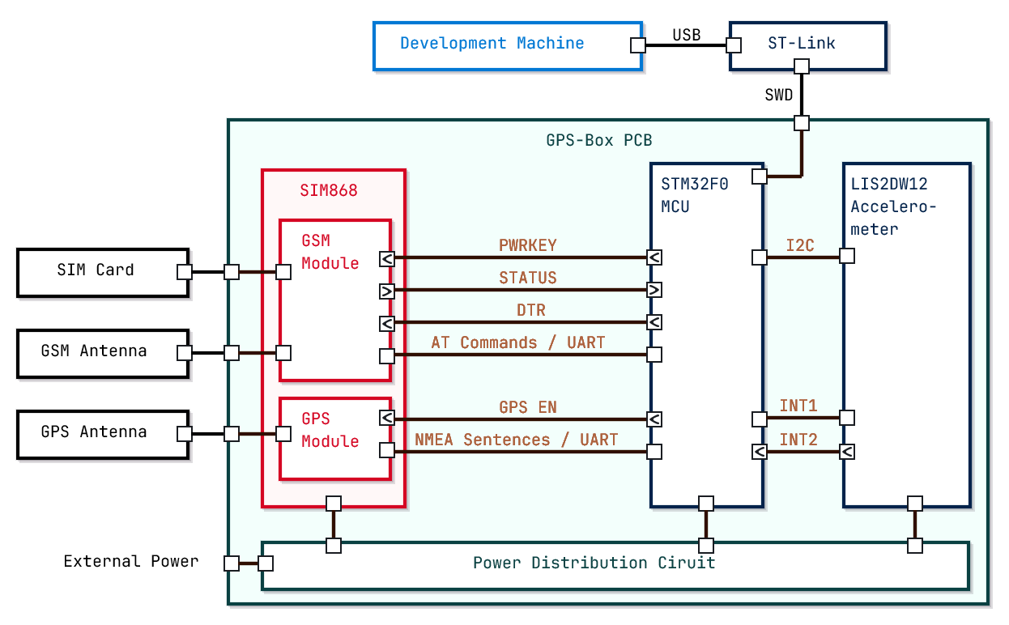
Components

Slide 13
GSM+GPS Module
Notes:
OTHER GPIOs

Slide 14
Communication
UART:
Device A
Tx
Rx
Rx
Tx
Device B
AT Commands:
AT+CSQ\r\n
AT+SAPBR=2,1\r\n
AT+CCLK?\r\n
+CME ERROR: 100\r\n
NMEA Sentences:
$PMTK220,1000*1F\r\n
$GNRMC,063847.000,V,,,,,,,,,,*71\r\n
Notes:
UART: full-duplex asynchronous
AT Commands
and
NMEA sentences
: semi-standardized ASCII-based protocols for controlling GSM and GPS modules respectively

Slide 15


Connectivity
GPRS
( 2.5G )
Internet
GSM Network
Notes:
GSM module allows GPRS internet access

Slide 16


Geolocation
GNSS Satellite Constellation
Trilateration
Notes:
GPS module allows geolocation using satellites

Slide 17
Accelerometer

Slide 18
Communication
I2C Bus:
Master
Slave
Slave
SDA
SCL
Register Access:
Read
Write
0 | 1 | 0 | 1 | 0 | 0 | 1 | 1
Notes:
I2C: master-slave bus, synchronous
→ register read/write

Slide 19


Accelerometer
Acceleration Measurement
Event Detection
Notes:
I2C → retrieve acceleration on each 3d axis
INT lines → detection interrupts (tap, freefall, orientation, etc.)

Slide 20
II
Embedded Software
1
Analysis & Design

Slide 21











Requirements
Processing
Transmission
Data
Collection
Reception
Maintainability
Configuration
Portability
Reliability
Responsiveness
Scalability
Time Keeping
Security
Notes:
Harness the potential of the modules

Slide 22
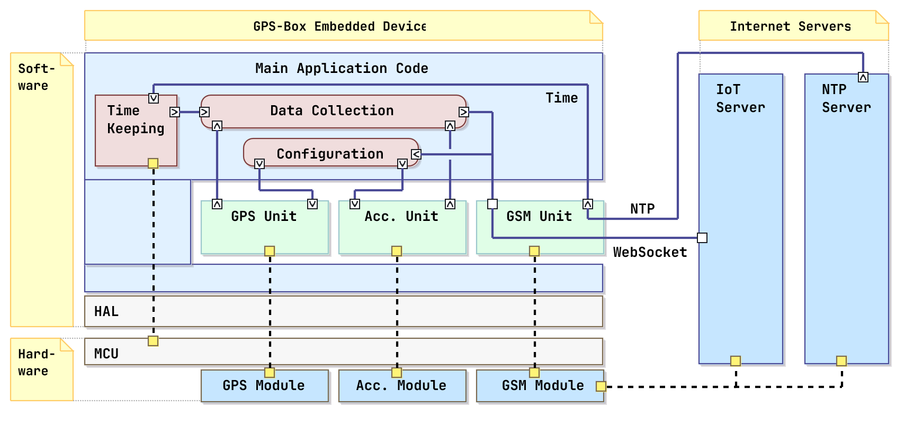
Architecture

Slide 23



Acc. Unit
Sampling Timer
Accelerometer Module
MAIN
Configuration Commands
Value, Ack, or Interrupt
Data or
Alert
Register Access
Manager Task

Slide 24
GPS Unit
Characters
Messages
Input Task
MAIN
Data
GPS Module
Output Task
Manager Task
Transmit
Init Commands
Configuration Commands
Notes:
Unlike I2C, UART is asynchronous, so two tasks are required for input and output
No need for a timer because, once configured, the module sends data periodically

Slide 25
GSM Unit
Characters
Messages
Data to Server
Input Task
MAIN
GSM Module
Data from Server
Output Task
Manager Task
Transmit
Commands

Slide 26
II
Embedded Software
2
Implementation

Slide 27
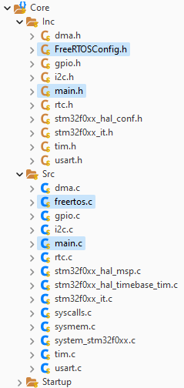
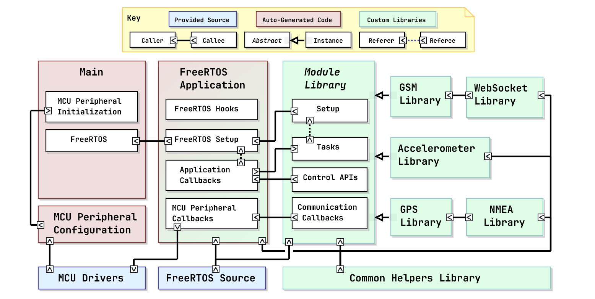



Main App. Code
Autogenerated
Scaffolding
+
Initialization
Provided Source

Slide 28
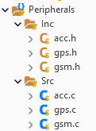
Custom Libraries
Custom Peripheral Libraries
Notes:
.h + .c
internal structure

Slide 29
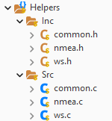
Custom Libraries
Custom Helper Libraries
Notes:
Commonly used functions
Hardware independent (for reasons that will later become apparent)
Dependencies

Slide 30
Full Code Structure
Notes:
CALLBACKS called by tasks on events, passed into setups

Slide 31
III
Monitoring System
1
Objective & Architecture

Slide 32





Objective
Data
Control
User
Client Browser
Internet
GPS-Box
Notes:
Communication:
Persistent
Real-time
Bidirectional
User interface

Slide 33

Device Comm.
Frontend Server
WebSocket
Backend Server
Notes:
Device connects using websocket

Slide 34
Client Connect
Request
Frontend Server
WebSocket
Backend Server
Notes:
User connects to server

Slide 35

Client Serve
Frontend Server
WebSocket
Backend Server
Notes:
Static files

Slide 36
Client Serve
Frontend Server
WebSocket
Backend Server
Notes:
Web app runs on browser

Slide 37
Client Comm.
Frontend Server
REST
WebSocket
SSE
Backend Server
Notes:
Web app connects to backend server
REST for USER→DEVICE commands
SSE for DEVICE→USER data

Slide 38
III
Monitoring System
2
Implementation

Slide 39
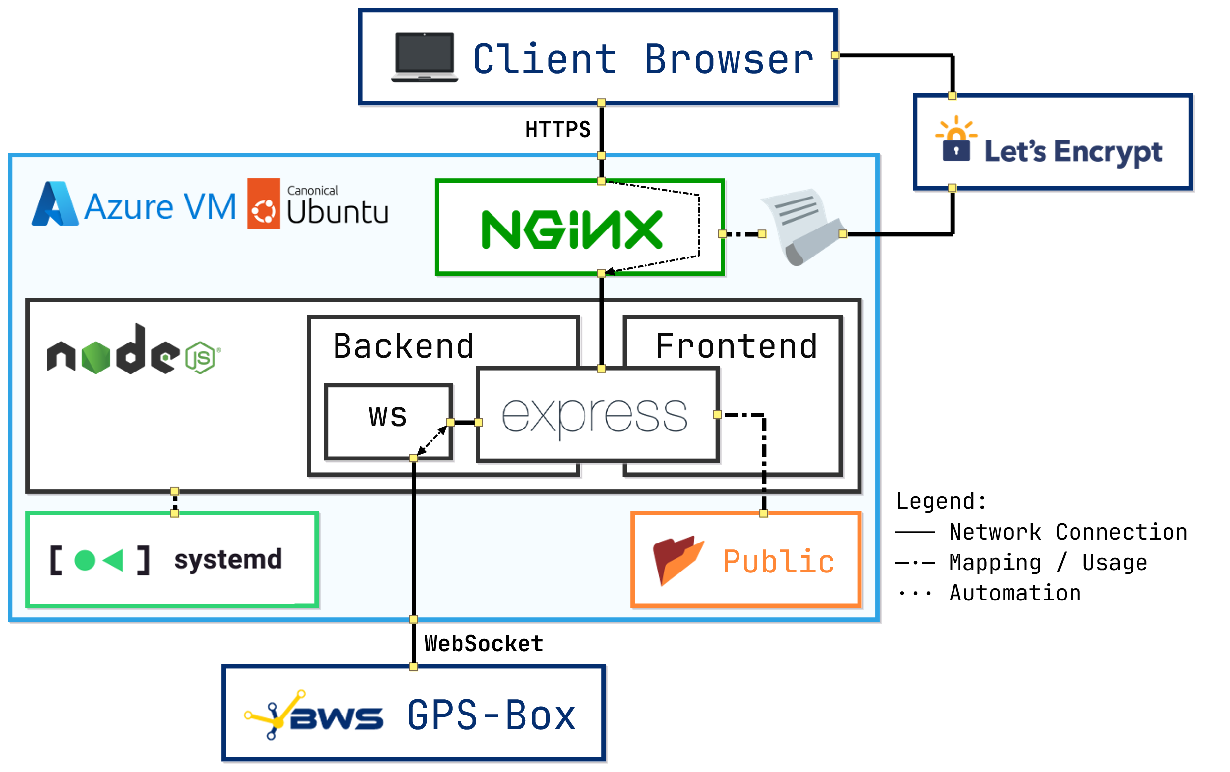
Implementation
Notes:
Both servers use NodeJS runtime and express framework to communicate with the user's browser
Backend uses ws library to communicate with GPS-Box
Frontend serves webapp as static files from the Public dir
NGINX reroutes HTTPS traffic, secured with a certificate from let's encrypt, to the servers
systemd starts the servers as services on boot, and keeps them running in the background
everything is hosted on an Ubuntu server VM on Azure cloud

Slide 40
III
Monitoring System
3
↗️
Demonstration
⏬

Slide 41
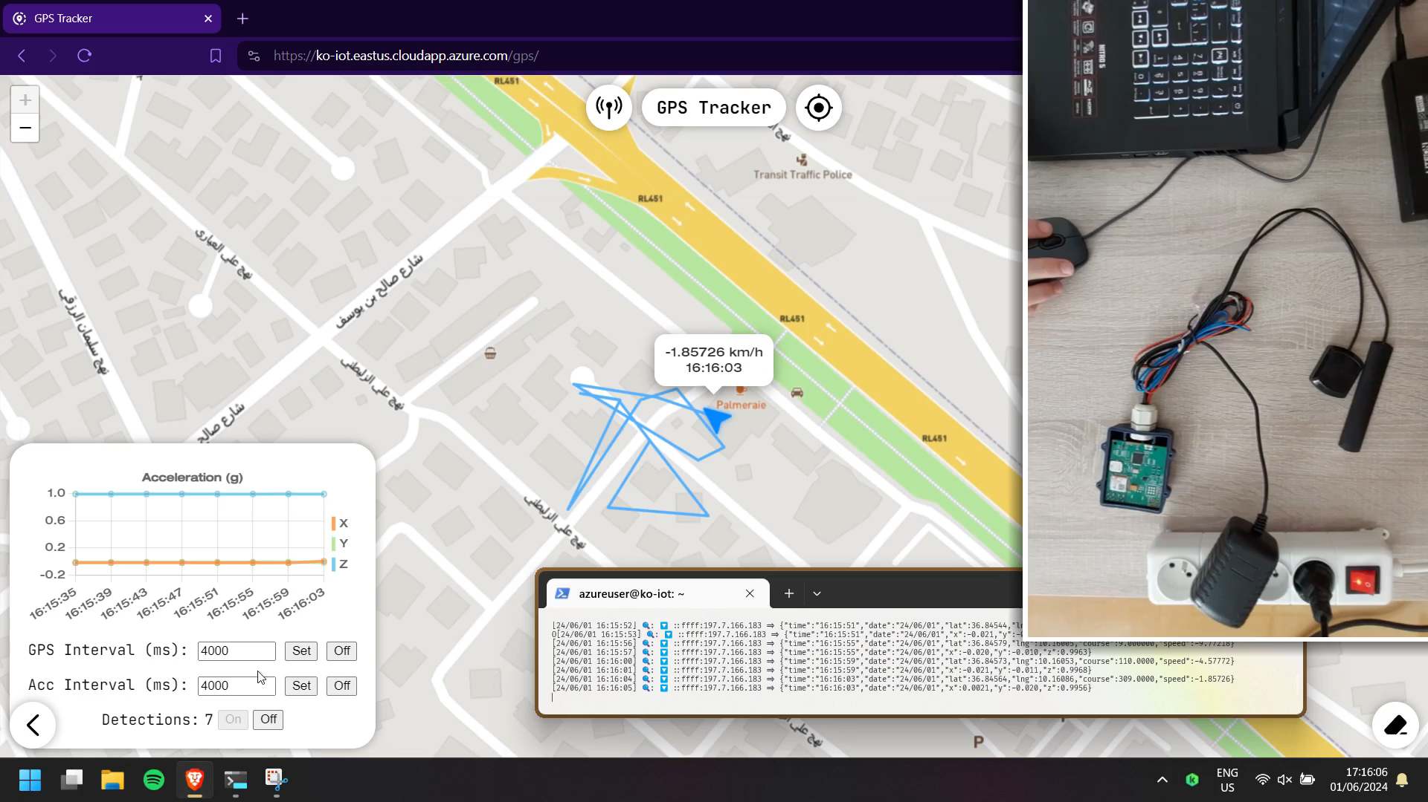
GPS
⏸️
Notes:
EXPLAIN CONTENTS
Disable Accelerometer
GPS 1s

Slide 42
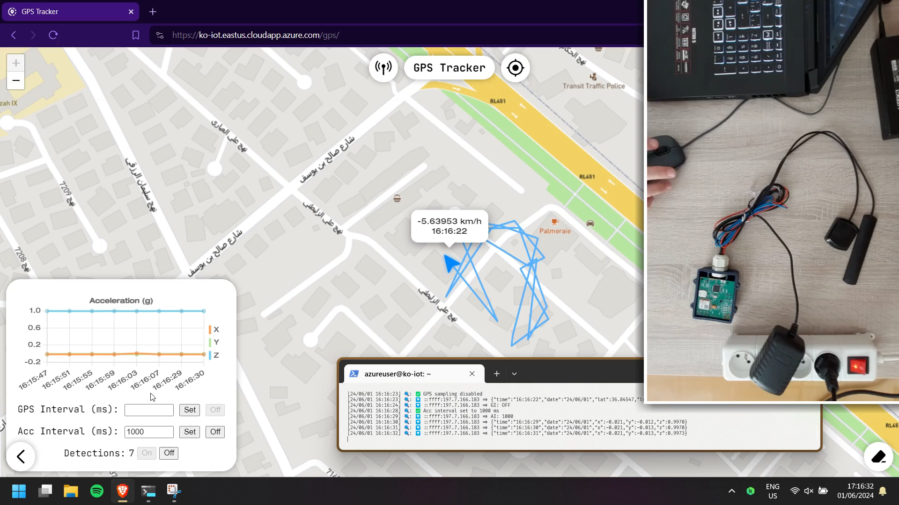
Accelerometer
⏸️
Notes:
Disable GPS
Accelerometer 1s
Rotate

Slide 43
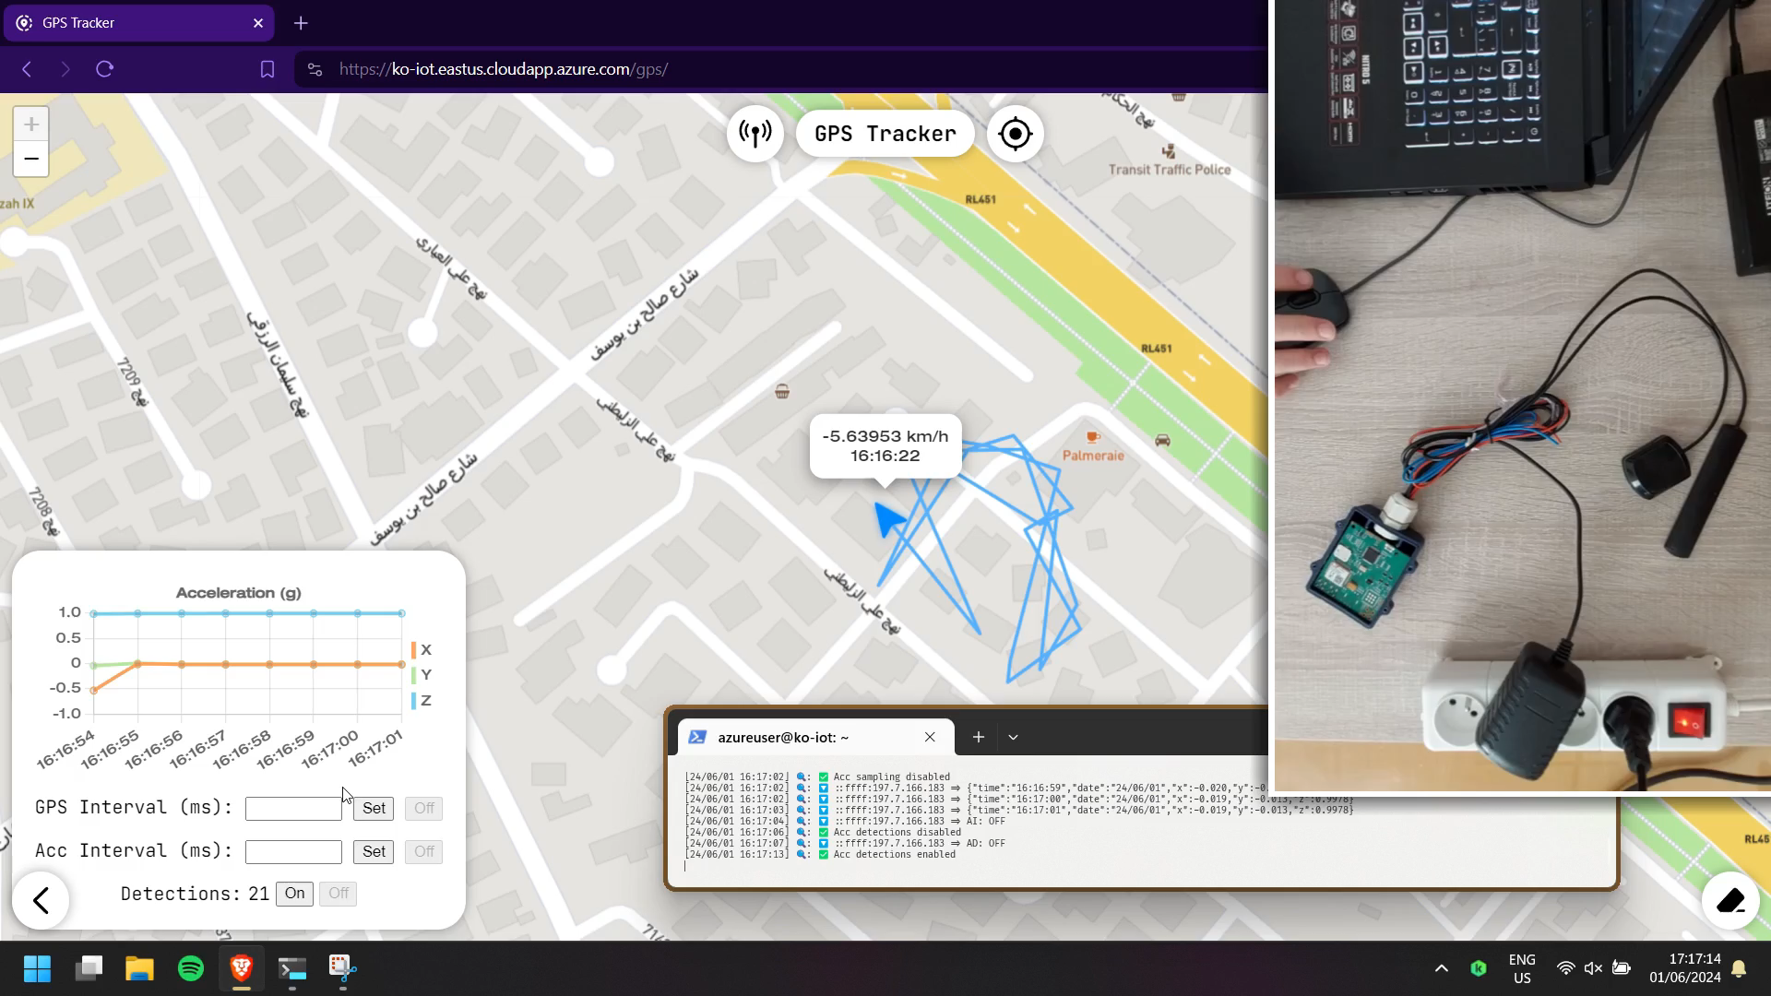
Detections
⏸️
Notes:
Tap → Detections inrcrement

Slide 44
IV
Embedded DevOps
1
Explanation & Challenges

Slide 45











Traditional Dev
Users
Deliver / Deploy
Flash
Test
Package
Review
Build
Debug
Share
Code
Share
Developer
Dev Team
Notes:
Traditional Embedded Software Development Lifecycle
Manual
Repetitive
Long cycle
Can forget steps
Different environments

Slide 46

CI/CD
Automated Pipeline
Users
Push Changes
Reintegrate Validated Changes
Shared Repository
Dev Team
Notes:
Streamline through automation

Slide 47


Embedded CI/CD
Challenge: Test Automation
Embedded Software
Target Hardware
Host
Machine
Notes:
Many embedded testing techniques exist
But only two were feasible given the constraints of this project

Slide 48
Testing Techniques
Off-Target
Unit Testing
✅ Requires no hardware
✅ Easy and fast
❌ Least faithful
❌ Only viable for part of the
software
Notes:
Units of code (functions)
are compiled and tested
in a black box manner
on the host machine

Slide 49
Testing Techniques
On-Target
System Testing
1. Flash
3. Report
✅ Most faithful
❌ Requires final hardware
❌ Requires dedicated version
❌ Requires logging interface
2. Run
Notes:
The final binary is flashed onto the target hardware
which runs the tests in a white-box fashion
and reports the results to the host

Slide 50
IV
Embedded DevOps
2
CI/CD Workflow

Slide 51
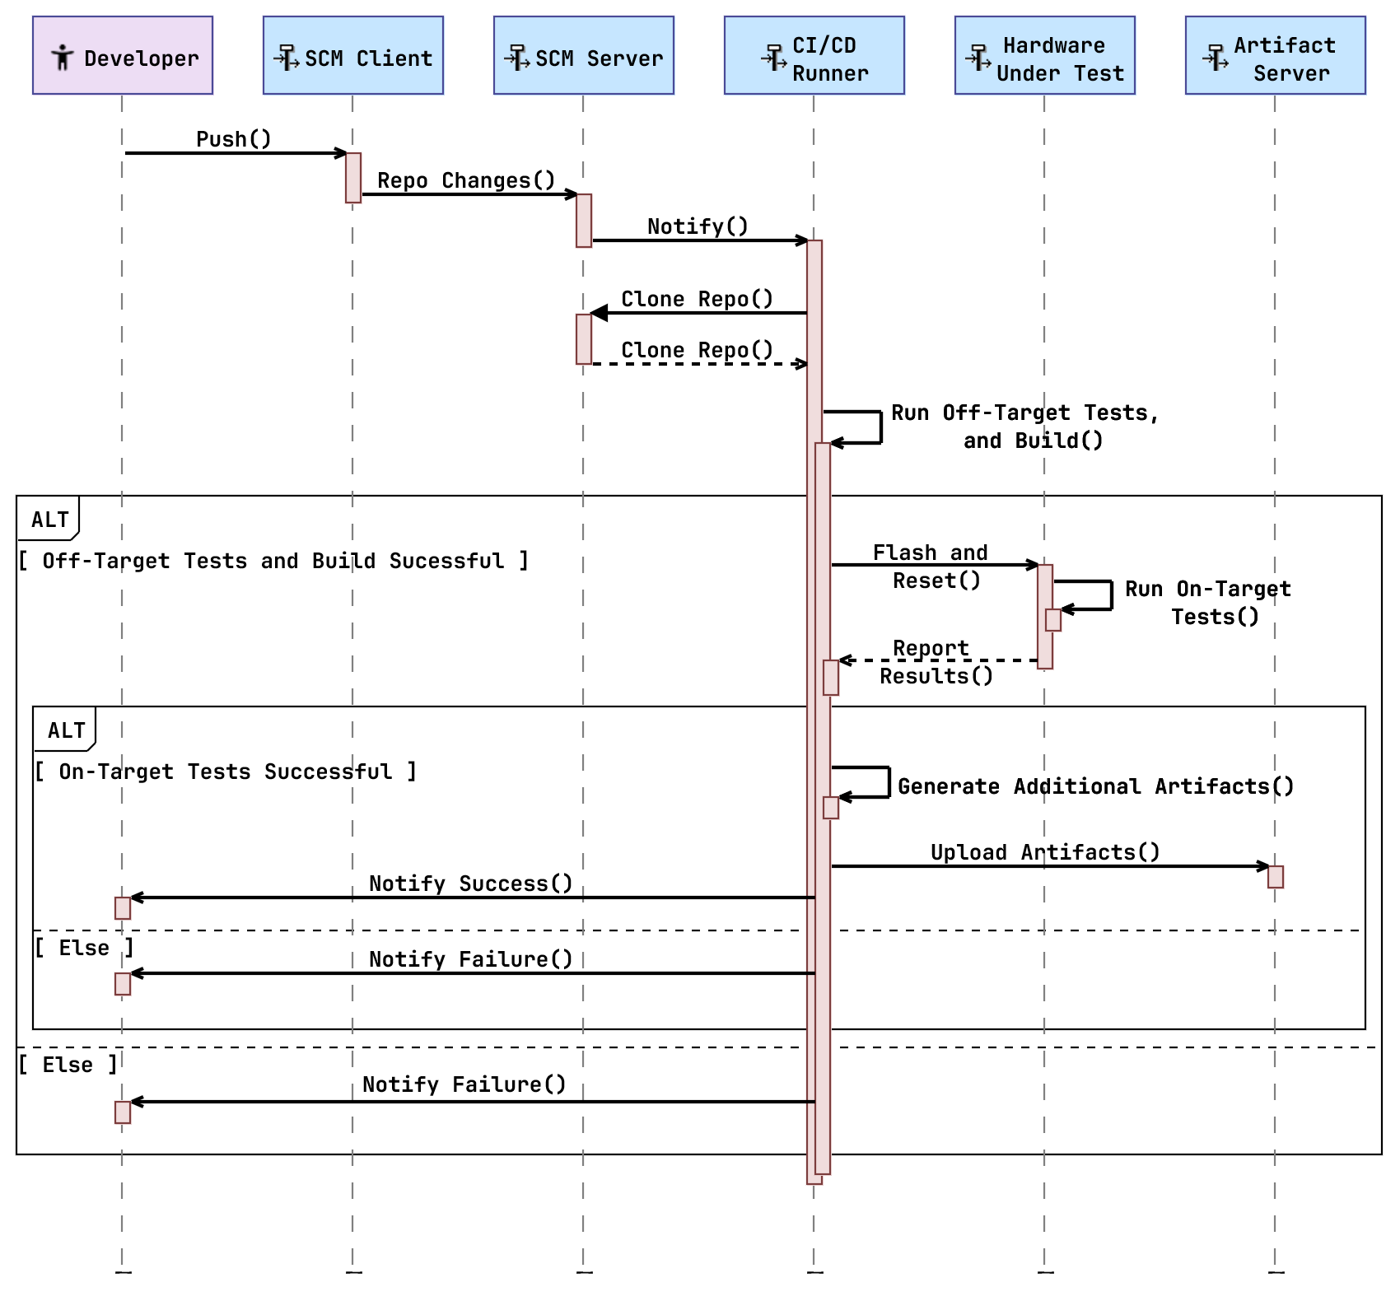
Notes:
Once the dev pushes their code changes to the Source Code Management server
the ci/cd is notified
and it clones the repo for local execution

Slide 52
Notes:
conducts off-target tests
and after building the binaries
conducts on-target tests as well

Slide 53
Notes:
If all goes well,
additional artifacts (documentation) are generated
and uploaded with the binaries to a server
otherwise
the developer is notified of the issue

Slide 54
IV
Embedded DevOps
3
Chosen Technologies

Slide 55
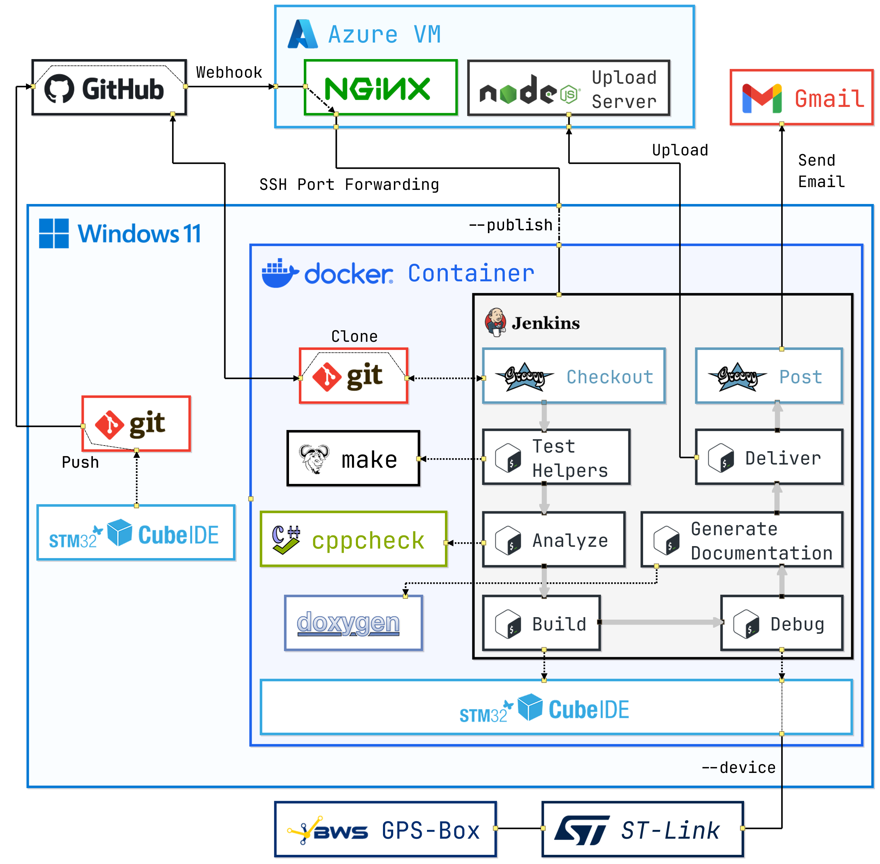
CI/CD Runner
Notes:
Pipeline stages

Slide 56
Container & Tools

Slide 57
Dev / Host Machine
Notes:
DOCKER → isolation and portability

Slide 58
SCM
Notes:
Most widely used
Jenkins runs locally →
NGINX reverse proxy: forwared webhook notification from GH to Jenkins

Slide 59
Delivery & Notif.

Slide 60
Overview

Slide 61
IV
Embedded DevOps
4
Demonstration

Slide 62
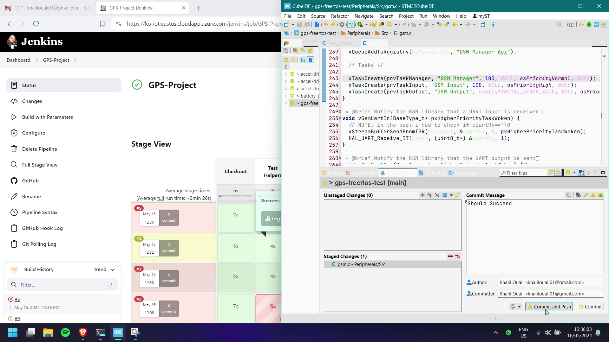
Ideal Run
Notes:
EXPLAIN INTERFACE
cubeide
browser
Jenkins dashboard
URL
pipeline
previous runs
email tab
Note the commit

Slide 63
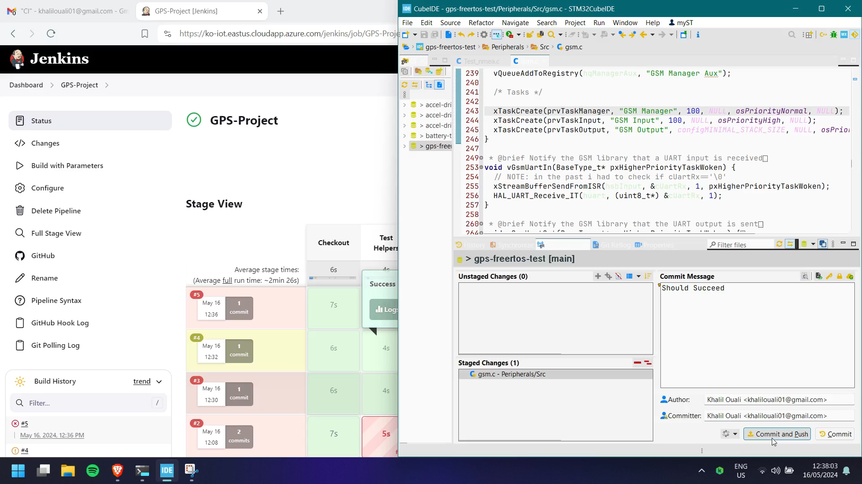
Ideal Run

Slide 64
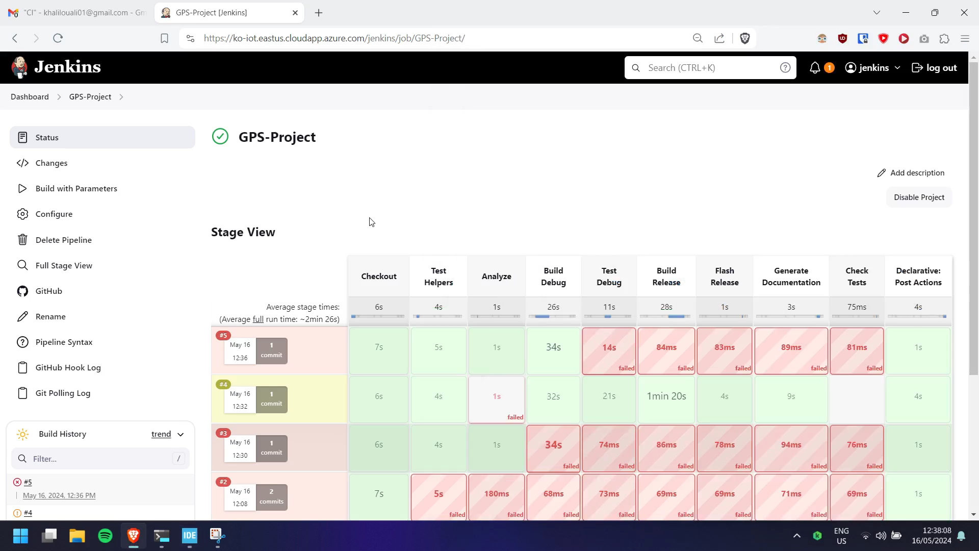
⏩×5
Notes:
Notification
Quiet time

Slide 65
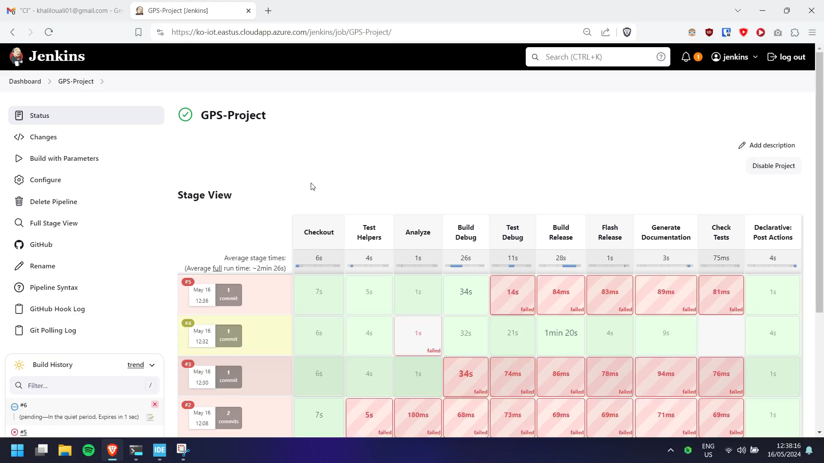
⏩×20
Notes:
STAGES
Building and on-target testing take longest
All stages complete successfully

Slide 66
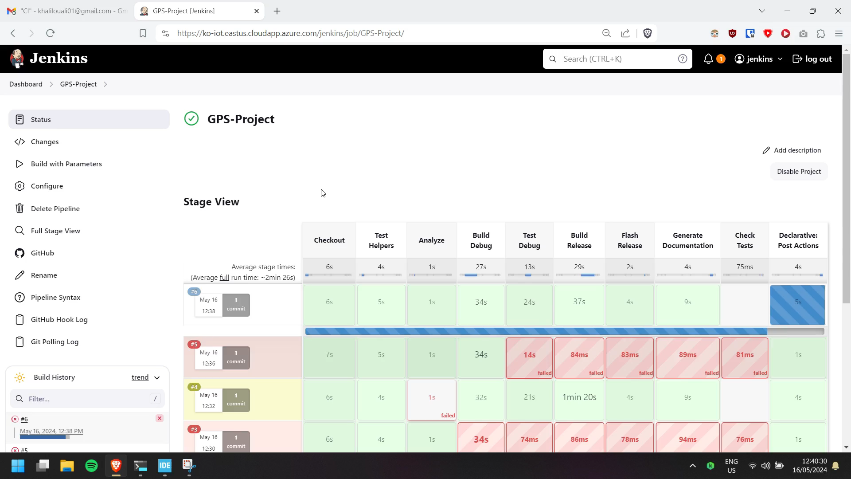

Slide 67
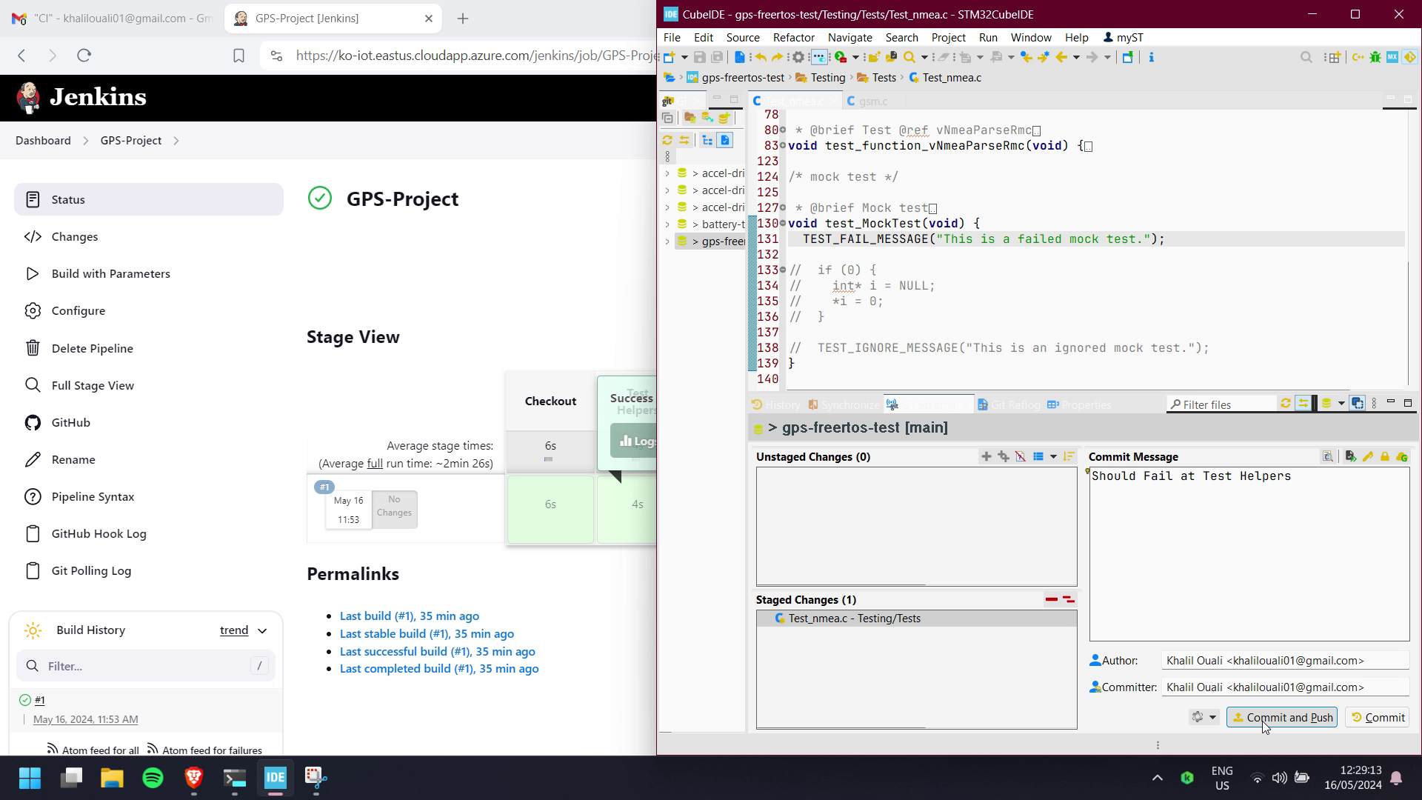
Off-Target
Test Fail
Notes:
Note the commit

Slide 68
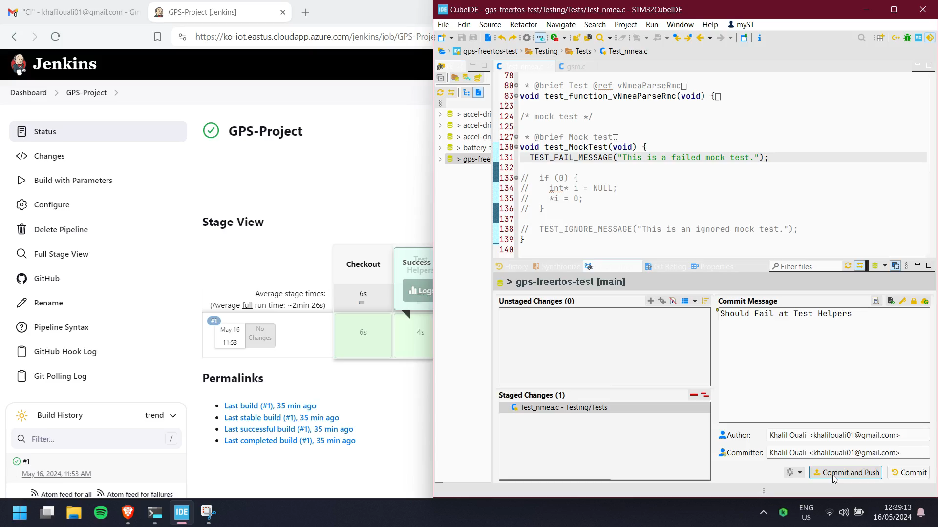
Off-Target
Test Fail

Slide 69

⏩×8

Slide 70
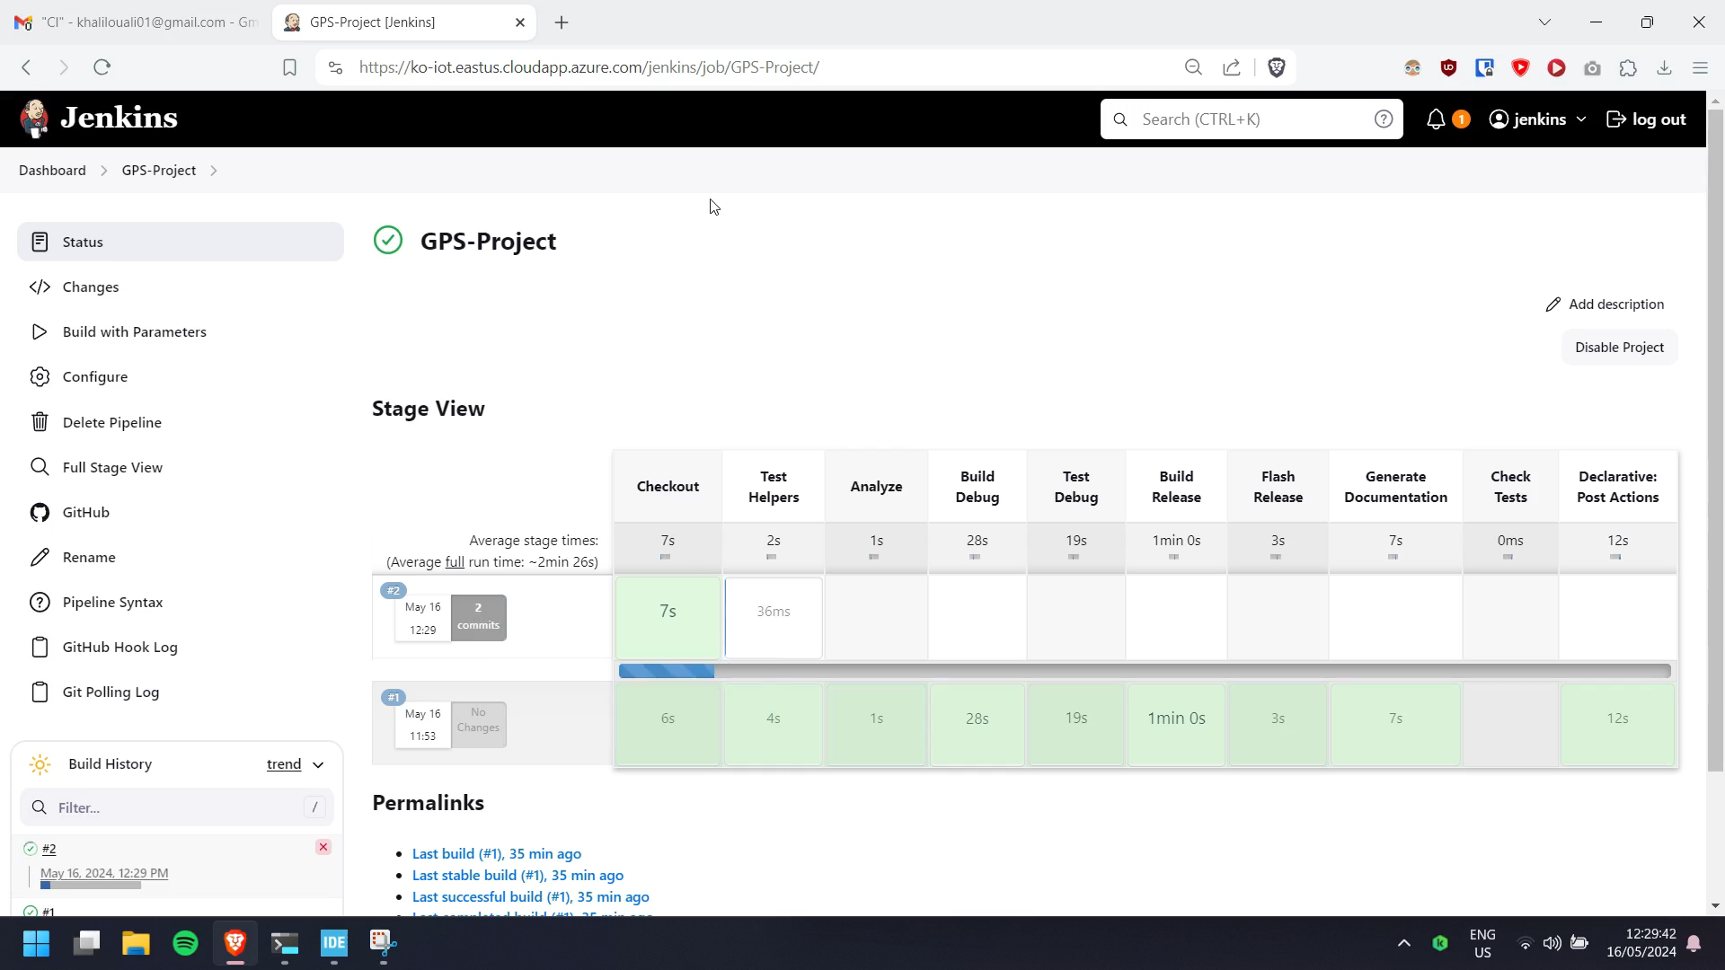
Notes:
note the email reception

Slide 71
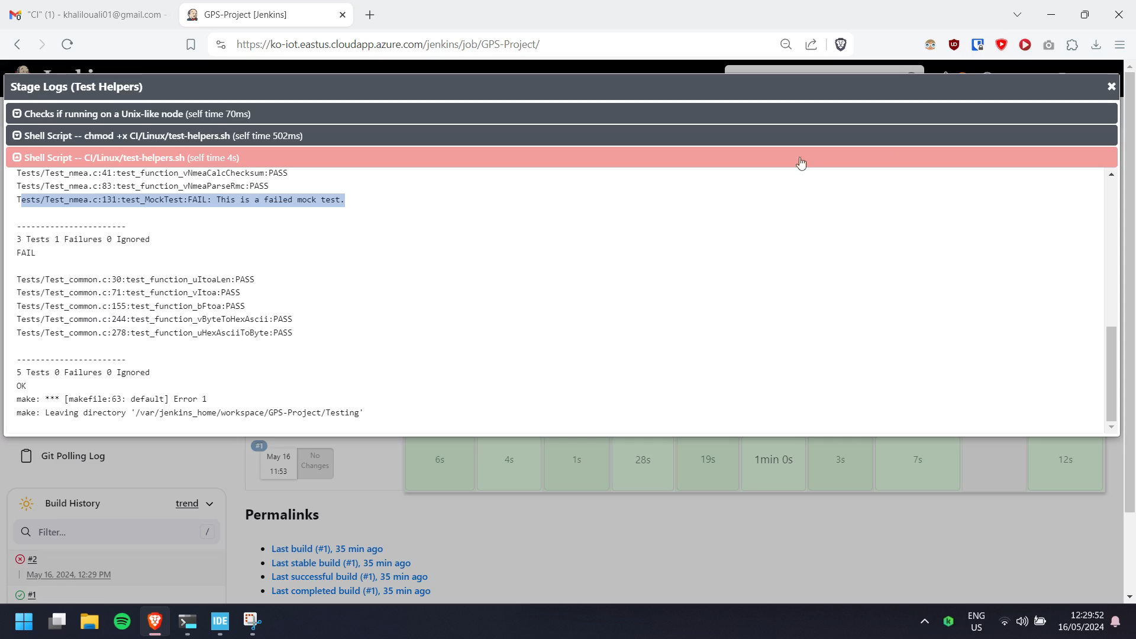
Notes:
note the email reception

Slide 72
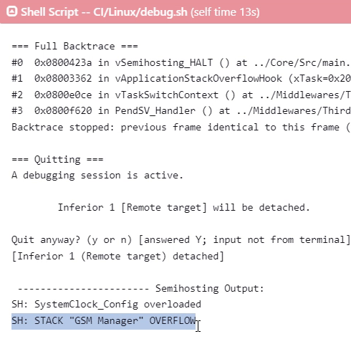
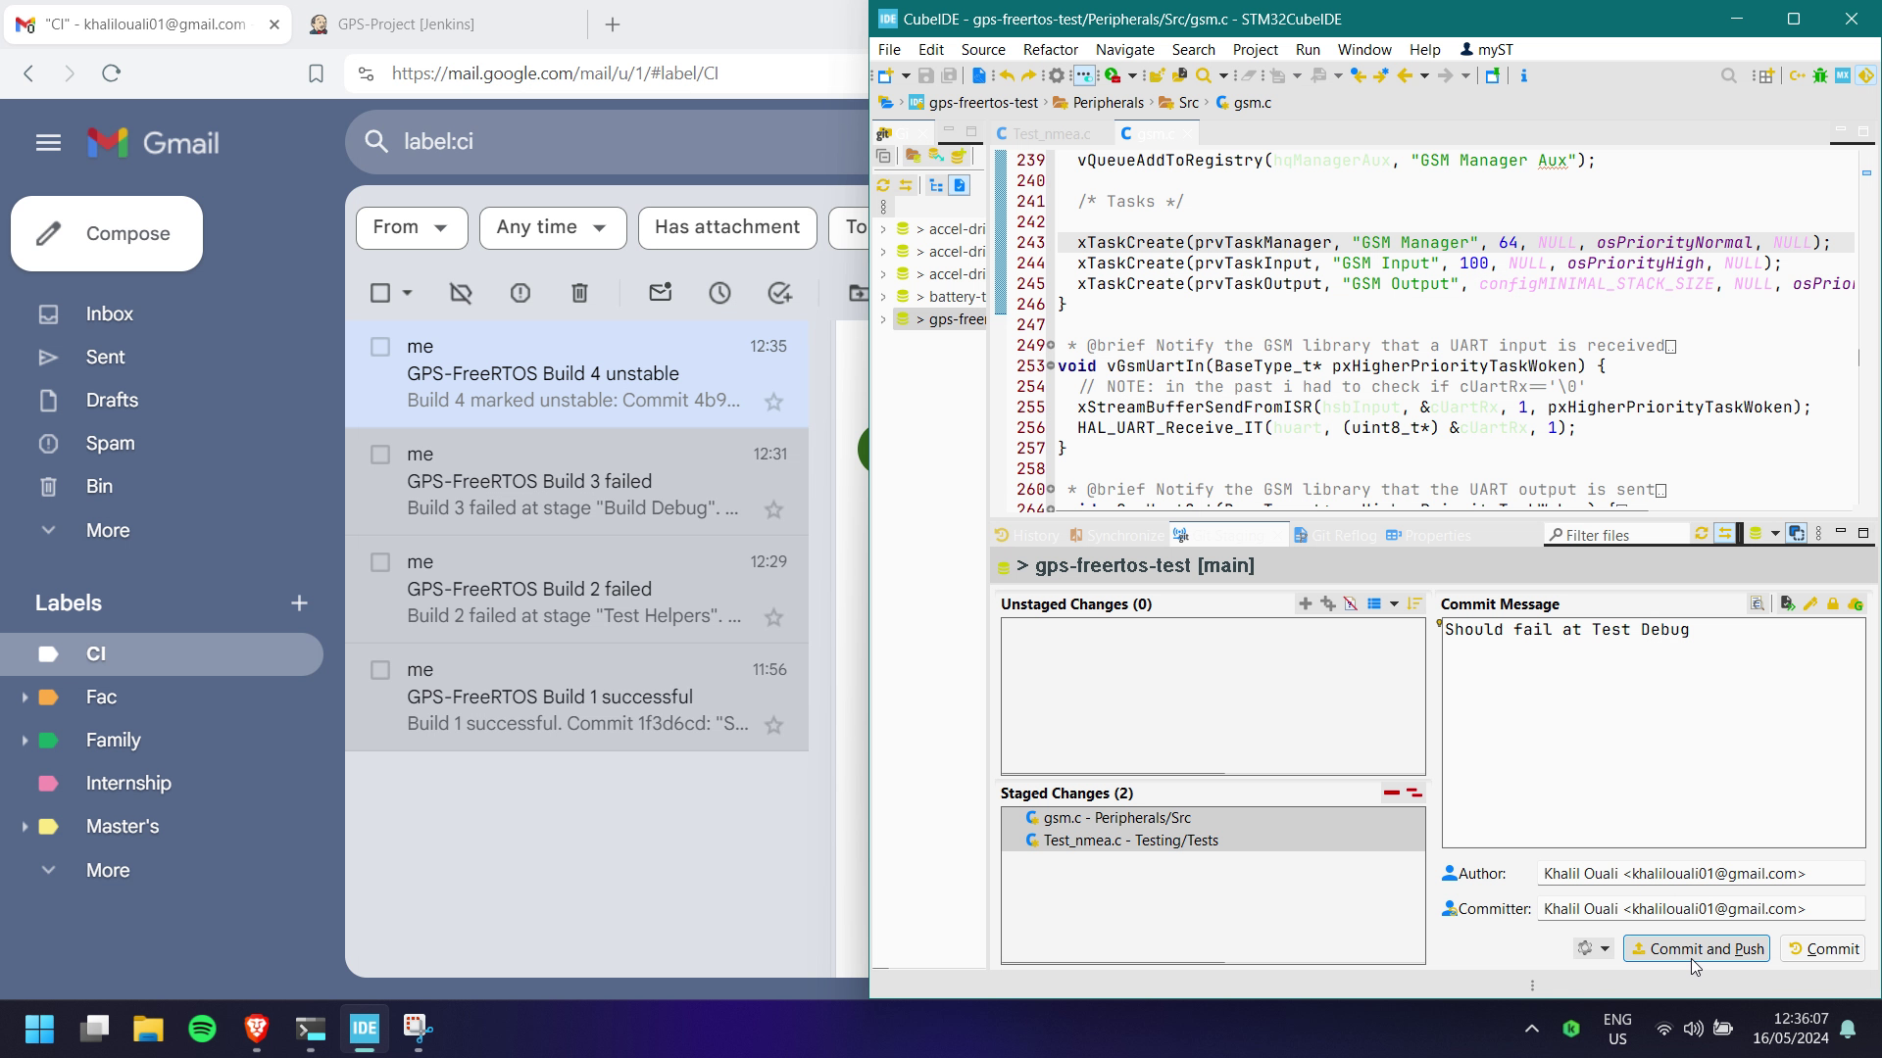
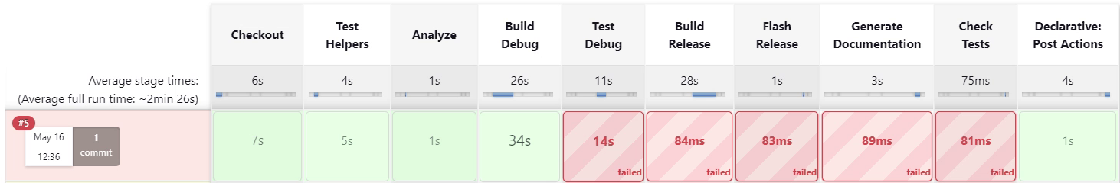
On-Target Test Fail
Reduce Stack Size
Notes:
→ simulate a stack overflow
FreeRTOS detects overflow at runtime → calls hook
→ output error via ARM semihosting
Email is sent
Similar scenario occurs if another stage fails

Slide 73
V
Conclusion

Slide 74






Review
RTOS-Powered
Codebase
Embedded Software
CI/CD
Control
Monitoring
Cloud
GPS-Box
Dashboard

Slide 75





Prospects
Device-Side TLS
IoT App. Protocol
Low-Power
Database
Multi-Device
FOTA

Slide 76
Thank you for your attention
I hope you found this presentation interesting

